Slide 1
Leader Interviews: Developing a View of the Whole System
www.cocreativeconsulting.com

Slide 2
Who we are
CoCreative helps people who don’t know each other (and often don’t even like each other) solve complex problems and create better futures together.
We work across sectors and industries, in public policy, development, energy, food, education, leveraging deep partnerships to create more thriving and resilient social systems.
We do this by designing and supporting collaborative innovation networks and collaborative strategy for high-impact social ventures.

Slide 3
Five Reasons to Interview System Leaders
Insight. Develop a shared picture of the system, including what and who will most impact progress toward our goal.
Strategy. Collect insight on where the system is working well and where the most powerful interventions points may be.
Engagement. Identify and cultivate key leaders who will be needed to advance work.
Goal Setting. Test and refine the working goal to get to a goal that is powerful and resonates across the system.
Downloading Leaders’ Perceptions. By learning what system leaders believe about the challenge, we see what insights will surprise them and disrupt their assumptions.

Slide 4
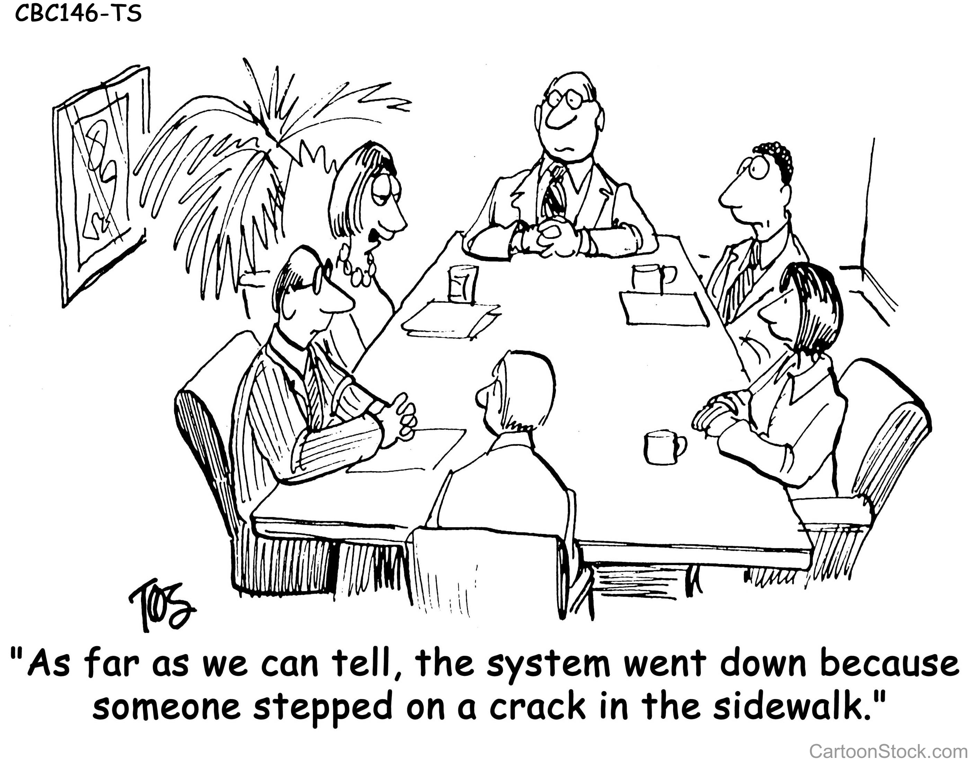
A Limited View

Slide 5
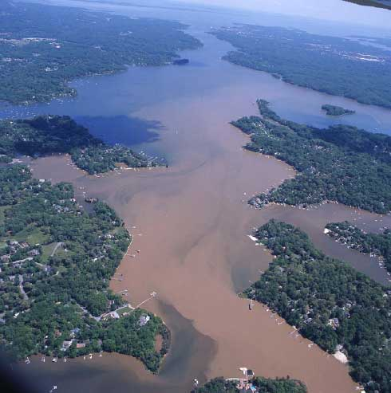
Two Types of Interviews
The System View can look quite different than the Experiential View.
Courtesy of Severn Riverkeeper Program
United States Department of Agriculture
We must understand and work from both views to change things.

Slide 6
The Flow of a System Leader Interview
Explore barriers & opportunities
30,000’
Introduce working goal
Test Interest
Connections to others
Connect to Initiative
Thanks & Next Steps
Learn about work & goals
Intro
Project
Intro
Yourself
Ground

Slide 7
Objectives of a System Leader Interview
Barriers/Forces Against Progress
Who We Are (Interests, Values, Challenges)
Opportunities/
Forces For Progress
Who They Are (Aspirations, Pain Points, Interests, Values)
Key Stakeholder
& Influencers
Testing Interest
Testing Desirability & Feasibility
Assessing Fit

Slide 8
Objectives of a System Leader Interview, Post-Launch
Who We Are (Interests, Values, Challenges)
Barriers/Forces Against Progress
Opportunities/
Forces For Progress
How this got started
The process and what’s emerged so far
Key Stakeholder
& Influencers
Testing Interest
Testing Desirability & Feasibility
Assessing Fit

Slide 9
Things to Avoid
Leading the Witness
Avoid asserting your perspective on the problem or how to address it.
Pushing for Commitment
These interviews should build interest and “pull” but shouldn’t be used to sell participation.
Asserting Analysis & Solutions
It’s good to test emerging thinking and possibilities, but keep them as possibilities, not proposals or recommendations.

Slide 10
Ask why
Summarize points, feed back, and test
Explore forces for and against the goal
Don’t suggest answers to your own questions
Ask questions neutrally
Don’t ask binary questions
Hunt for the underlying interests, concerns, and values
Asking Questions
Photo by Petty Officer 3rd Class Robert Brazzell, US Coast Guard

Slide 11
Get clear about what you want to learn
Test the goal as a “what would it take to do this” proposition
Look for key motivations—why would they want to get involved?
Look for fears and frustrations—what concerns them most?
Look for new perspectives—what will change our assumptions?
Test thinking and possibilities
Gaining Insights

Slide 12
More learning, tools, and resources
Free tools and materials on our website:
www.cocreativeconsulting.com/tools
And we’d love to hear from you!
talktous@cocreativeconsulting.com
Don’t forget to send us a tweet!
@WeAreCocreative
Training courses:
Collaborative Innovation Essentials (DC, Seattle, & Oakland)
Collaborative Leadership Essentials (DC & Oakland)
Leveraging Conflict for Innovation
Design & Systems Thinking for Transformational Change
Advanced Collaborative Leadership

