Slide 2
Shared Intent: Laying the Foundation for Powerful Collaboration
www.cocreativeconsulting.com

Slide 3
Who we are
CoCreative helps people who don’t know each other (and often don’t even like each other) solve complex problems and create better futures together.
We work across sectors and industries, in public policy, development, energy, food, education, leveraging deep partnerships to create more thriving and resilient social systems.
We do this by designing and supporting collaborative innovation networks and collaborative strategy for high-impact social ventures.

Slide 4
Agenda
WEDNESDAY
8:15 | LIGHT BREAKFAST
8:45 | Welcome, Introductions, Intended Outcomes
10:00 | Network Roles
10:15 | BREAK (15m)
10:30 | Aligning Shared Intent (lecture, application, integration)
12:00 | LUNCH (45m)
12:45 | Connecting the Change System: (lecture, application, integration) Identifying the right stakeholders, Stakeholder Interviews, developing interview insights
2:00 | BREAK (15m)
2:15 | Connecting the Change System: Continued
4:25 | Reflection and Close
5:00 | Adjourn

Slide 5
Agenda
THURSDAY
8:15 | BREAKFAST
8:45 | Reflections and Learning from Day 1
9:15 | Connecting the Change System: Developing Interview Insights application
9:45 | Convening the Network: Hosting the Launch Session
10:30 | BREAK (15m)
11:15 | Convening the Network (cont.)
11:35 | Learning About the System we intend to change
12:00 | LUNCH (45m)
12:45 | Learning About the System we intend to change
1:15 | Designing interventions (lecture, application, integration)
2:45 | BREAK (15m)
3:00 | Designing interventions (continued)
3:15 | Making and Testing Solutions (Developing Concepts)
4:30 | Reflection and Close
5:00 | Adjourn

Slide 6
Agenda
FRIDAY
8:15 | BREAKFAST
8:45 | Reflections and Learning from Day 2
9:00 | Making and Testing Solutions (Prototyping)
10:40 | BREAK (15m)
10:55 | Scaling Solutions
11:20 | Organizing the Network
11:40 | Desired Outcomes
12:20 | Reflections & Appreciation
1:00 | CLOSE

Slide 7
The Collaborative Innovation Roadmap

Slide 8
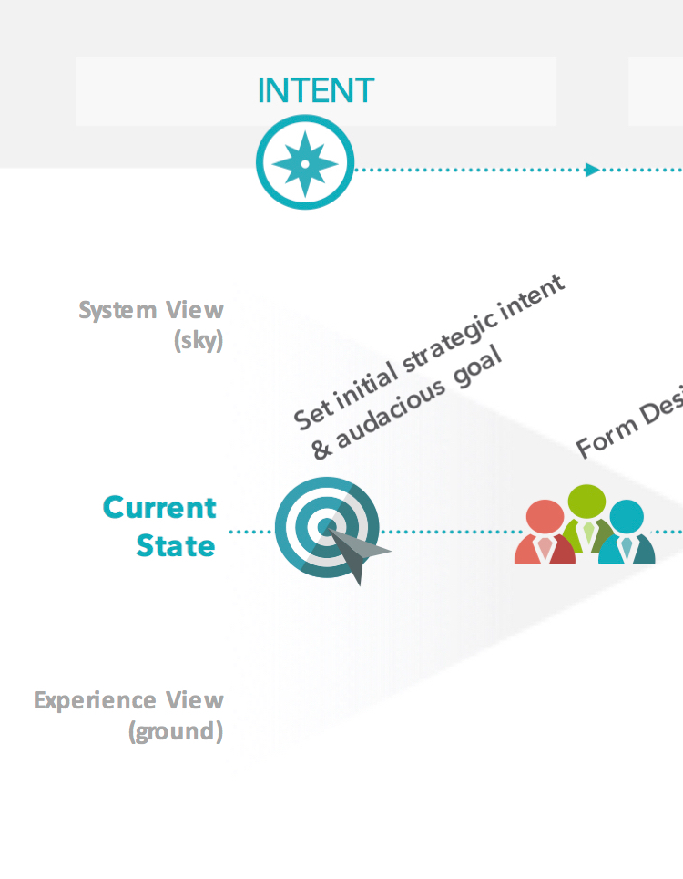
Why is Shared Intent so Important?
A clear and powerful shared intent provides the rationale for working across boundaries, taking risks, and thinking and action “at scale.”

Slide 9
3 Key Elements of a Powerful Shared Intent
Powerful Goal
Creating a goal that inspires and galvanizes organizations to come together to make it happen.
Focus & Frame
Scoping the work to prevent unproductive conflict and increase shared ownership.
Critical Shifts
Defining a clear problem space in which to co-design powerful solutions.

Slide 10
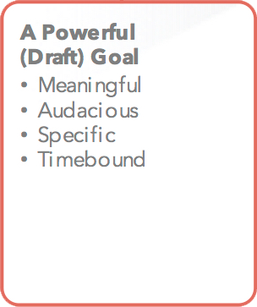

Slide 11
Why is a powerful goal important?
A powerful goal:
Inspires and galvanizes commitment (i.e. it’s big enough for me to care and want to be a part of it).
Forces us to think and act at scale. It doesn’t allow people to rationalize activities that won’t add up to impact.
Gets beyond single solutions (e.g. “Just give me the funds and I’ll get this done.”)
Makes collaboration make sense (i.e. we understand that one entity can’t do it alone and many diverse organizations will have to come together to make it happen).
Points everyone in the same direction.

Slide 12
Anatomy of an Effective Goal
Meaningful
Audacious
Specific
“We guarantee that 100% of third-grade youth will be reading at grade level by 2023 in all DNATL schools.”
Timebound
Example of an Ineffective Goal
“We’re going to improve third grade reading levels.”

Slide 13
Defining a Focus & Frame
Why it’s useful…
It helps us move forward with an agreement that usually works for all.
It helps us avoid unintended impacts on related goals that just outside the group’s current focus.
It helps us look for opportunistic wins that will advance interests in both our Focus and our Frame.

Slide 14
Defining a Focus & Frame
Example of a Focus & Frame
Focus | Frame
Eliminate worker exposures to hazardous chemicals in the global electronics supply chain. | Reduce environmental discharges of hazardous chemicals from electronics facilities.

Slide 15
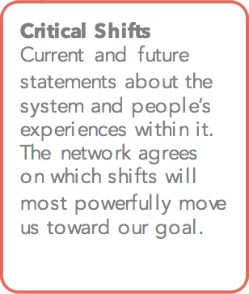

Slide 16
Critical Shifts
Why they are useful…
Force stakeholders to agree on the problem before jumping to potential solutions.
Provide a strategic way to identify the most critical leverage points to maximize social return on investment.
Provide a clear problem-solving space to focus the development of solutions.
Help avoid favored solutions by focusing on the needs first.
Provide a basis to evaluate possible solutions over time, and avoid solutions that aren’t paying off.

Slide 17
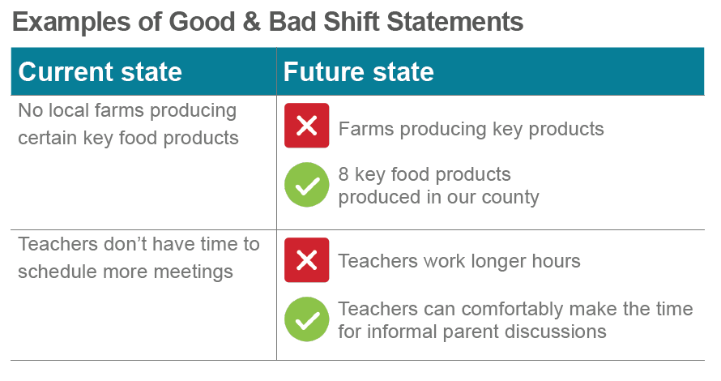
Developing Critical Shifts

Slide 18
Two Types of Critical Shifts
System Shifts
Arise from expert/system leader interviews.
Are current and future statements about the features of the whole system, like policies, infrastructure, tech, financial, etc. that influence how the system works.
Experience Shifts
Arise from empathy interviews.
Are current and future statements that begin with “I” to identify with the human experience (feelings, motivations, and/or behaviors).

Slide 19
1. Growing the New
Growing Green, Progressive, and Ethical Banks | We don’t have many green/progressive/ethical banks and the ones we do have tend to be small and constrained in their ability to grow, even though the demand is there. And they are potential acquisition targets because of increasing M&A pressure and shareholder impatience. | We have a flourishing green/progressive/ethical banking sector with a high share of market, and few barriers to growth. They are attractors and beacons demonstrating innovation and leadership in establishing new markets and financing solutions for climate-positive lending.
Growing Greener Public Banks | We don’t have many public banks and they haven’t necessarily integrated climate into their missions, policies, and programs. | We have a flourishing public banking sector that is leading infrastructure investment in key sectors, and using its public financing and regional bank sector support services to advance climate-positive retail lending.
Growing Greener Stakeholder Banks | We have some stakeholder banks (that include credit unions, mutual, and coops) but even where they exist they haven’t necessarily integrated climate into their missions, policies, and programs. | Do this later
Critical Shifts

Slide 20
2. Changing the Old
Reducing Harm | Big banks are actively investing in projects and businesses that are the major contributors to climate change. | They are not.
Creating a Race to the Top | Big banks’ financing of climate solutions is uneven and insufficient to meet the scale of the 2º challenge. | Climate is integrated into every strategic and loan decision made by big banks to a degree that is consistent with the 2º challenge.
3. Measuring Impact Performance
Bank Impact Measurement | Banks don’t understand how they are doing on climate and can’t compare their impact to other banks. | Banks have a reliable and fully implemented standard and practice around measuring climate impact.
Bank Impact & Risk Assessment & Disclosure | The climate impact and risk of banks and their clients’ portfolios are not generally disclosed. | Regular and complete climate risk and impact assessment and disclosure is the norm for the banking sector and we’re able to assess the performance of the whole sector.
Critical Shifts

Slide 21
More learning, tools, and resources
Free tools and materials on our website:
www.cocreativeconsulting.com/tools
And we’d love to hear from you!
talktous@cocreativeconsulting.com
Don’t forget to send us a tweet!
@WeAreCocreative
Training courses:
Collaborative Innovation Essentials (DC, Seattle, & Oakland)
Collaborative Leadership Essentials (DC & Oakland)
Leveraging Conflict for Innovation
Design & Systems Thinking for Transformational Change
Advanced Collaborative Leadership

