Slide 1
Leveraging Tensions for Innovation A Quick Introduction
www.cocreativeconsulting.com

Slide 2
Who we are
CoCreative helps people who don’t know each other (and often don’t even like each other) solve complex problems and create better futures together.
We work across sectors and industries, in public policy, development, energy, food, education, leveraging deep partnerships to create more thriving and resilient social systems.
We do this by designing and supporting collaborative innovation networks and collaborative strategy for high-impact social ventures.

Slide 3
Polarities aren’t new.
NOT A FLAVOR OF THE MONTH
>1,000 BC I Ching and earlier trigrams & Yin/Yang polarity
500 BC Lao Tzu documents Taoist philosophy, we can “transcend” dualistic thinking
500 BC Heraclitus talks about the “unity of opposites,” all change comes through struggle of opposites
1,300 AD Aztec belief in Teotl, an all-encompassing force comprised of opposites. In order for the universe to be created, these opposites had to come together.
30 AD Ardhanarishvara represents the synthesis of masculine and feminine energies of the universe (Purusha and Prakriti) and illustrates how Shakti, the female principle of God, is inseparable from Shiva, the male principle of God
400 BC Plato writes in the Phaedo, "Everything arises in this way, opposites from their opposites."
1816 Drawing on the works of Hericletus and Kant, Hegel proposes an “identity of difference,” that we know a thing by it’s opposite or context.
1938-1965 Jung identifies dualistic pairs in personality and points to the latent energy and developmental potential in one's shadow. Based on Heraclitus, introduces Enantiodromia—the superabundance of any force inevitably produces its opposite.
1985 Dr. Charles Hampden-Turner describes Dilemma Theory and cycling back and forth between seemingly opposing values.
1994 De Wit and Meyer advocate a dialectical approach to strategic paradoxes and complexity, rather than treating them as puzzles, dilemmas, trade-offs, or averages.
1996 Dr. Barry Johnson publishes "Polarity Management.”
2004 Lowy and Hood describe the 2x2 thinking approach used by consultants beginning in the 1970’s; involves optimizing the benefits of opposition, creative tension, iteration and transcendence to make better decisions.
Notes:
Values coming in pairs is a narrower base than interdependent pairs in life. Activity and Rest is a polarity but many people would not associate values with it. Also inhaling and exhaling. My point is that the notion of interdependent pairs is both more inclusive and less likely to generate questions early in the process that values pairs might generate.

Slide 4
Places to Intervene in a System (Meadows)
12. Constants, parameters, numbers (such as subsidies, taxes, standards);
11. The sizes of buffers and other stabilizing stocks, relative to their flows;
10. The structure of material stocks and flows (such as transport networks, population age structures);
9. The lengths of delays, relative to the rate of system change;
8. The strength of negative feedback loops, relative to the impacts they are trying to correct against;
7. The gain around driving positive feedback loops;
6. The structure of information flows (who does and does not have access to what kinds of information);
5. The rules of the system (such as incentives, punishments, constraints);
4. The power to add, change, evolve, or self-organize system structure;
3. The goals of the system;
2. The mindset or paradigm out of which the system—its goals, structure, rules, delays, parameters—arises; and,
1. The power to transcend paradigms.

Slide 5
SEEING POLARITIES

Slide 6
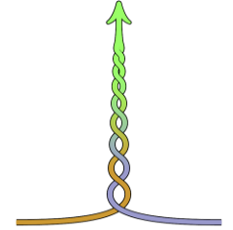
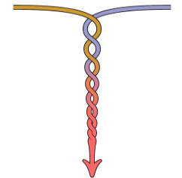
Experiencing interdependence
THRIVE
Release Carbon Dioxide
Get Oxygen
Quick
Autonomic
Inhale
Exhale
or
and
Can be optimized
Too Much Carbon Dioxide
Not Enough Oxygen
DIE
Based on the work of Polarity Partnerships, LLC

Slide 7
Some polarity tensions you’re familiar with…
Assertive & Cooperative
Serving & Leading
Vision & Current Reality
Internal & External
Individual & Collective
Introversion & Extraversion
Stability & Change
Short-term & Long-term
Intent & Impact
Planning & Execution
Internal focus & External focus
Freedom & Equality
Work & Home
Preserve Core & Stimulate Change
Power & Love
Centralization & Decentralization
Activity & Rest
Action & Reflection
Mission & Margin
Justice & Mercy
Notes:
Cliff:
The values in each pair are interdependent—they need each other
To get the best of both, we need both
The tension you chose earlier has a pair of values behind it (e.g. home and work)

Slide 8
Many values, many polarity tensions…
individual & collective | interior & exterior | individual behavior & personal meaning | systems and processes & culture and shared values | rational & intuitive | logical & metaphorical | sequential & synthesizing | details & big picture | plan & improvise | verbal & visual/kinesthetic | analyze & imagine | objective & subjective | parts & wholes | observe & imagine | facts & inspiration | prove/verify & envision | reduce & expand | preparation & incubation | pattern perception & spacial perception | sort/separate & infuse/blend | discern & generate | divergent & convergent | facts & story | levels/stages & dimensions | successive & simultaneous | strategies & possibilities | segmented & contextual | independent & interdependent | distinctions & interrelations | evaluation & imagination | categorize & assimilate | finite & infinite | projection & introjection | manage & lead | lead & follow | stability & change | focus on productivity & focus on relationships | advocacy & inquiry | talking & listening | reality & vision | head & heart | making a life & making a living | absolute truth & relative truth| reason & faith | contextual & normative | did/past/present & present/future/do | enlightenment, consciousness, (manifestation) & illusion, pre or unconscious (incubation) | known & unknown | evolutionary & revolutionary | incremental & breakthrough | deliberate & emergent | vertical (efficiency/hierarchy/functional) & horizontal (speed/flat/matrix) | short-term/here-and-now & long-term/future | hold responsible & give freedom | analytical & theoretical | accuracy & completeness | breadth & depth | reactive & proactive | objective & subjective | quantitative & qualitative | tangible & intangible | deductive & inductive | competence & respect | focus on self & focus on other | intent & impact | intellect & affect | learning from books & learning from experience | above the neck learning & below the neck learning | competition & cooperation | materialization & intention | order & emergence | direction & participation | choice & compliance | mandatory & discretionary | implement & plan | action & reflection | output & input | task & relationship | content & context | situational & uniform | consistency & versatility | durability & pliability | results & process | swiftness & mindfulness | efficiency & effectiveness | work & home | standardization & innovation | consistency & agility | structured/clear /focused & flexible/open/expansive | accountability & support | accountability & freedom | candor & diplomacy | intent & impact | commitment & possibilities | left-brain & right brain | decentralized & centralized | autonomous & integrated | detachment & attachment | custom information & common information | will & humility | debate & unity | consistent & adaptable | control & empowerment | negotiation & ventilation | caution & risk | self & other | individual & collective | part & whole | care for self & care for others | true to self & loyal to others | superstars & teamwork | internal stakeholders & external stakeholders | being the best & doing the best | doing things right & doing the right things | forgiveness & apology | self service & community service | differentiation & integration | independence & interdependence | teach & learn | speak & listen | push & pull | risk & safety | participate & observe | opaque & transparent | fairness & equality | exclusion & inclusion | independence & interdependence | individual effort & group effort | culture & multi-culture | homogeneity & diversity | specialist & generalist | functional & beautiful | logic & creativity | customer service & service to organisation | anticipate customer needs & respond to customer feedback | manage costs & equip people | seriousness & playfulness | direction & participation | advocacy & inquiry | discipline & encouragement | efficient & effective | market driven & product driven | control costs & improve quality | faster & better | maintenance & emergence | expectations & discovery | reserved & enthusiastic | preserve & grow | converge & diverge | seriousness & humor/fun | image & substance | cutting edge & continuous improvement | method & meaning | discretion & openness | realistic & optimistic | sagely wisdom & child-like inquiry | complexity & simplicity | uniqueness & connectedness | awareness & skills application | understand/appreciate self & understand/appreciate others | inquiring/learning & sharing/teaching | care for self & opening self | candor & diplomacy | conditional respect & unconditional respect | space for self & space for others | recruitment & retention | individual identity & organisation assimilation | policies/systems & practices/behaviors | organisational goals & individual goals | develop talent & utilize talent | diversity & meritocracy | honest organisation self-assessment & awards/rewards | extroversion & introversion | sensing & intuition | thinking & feeling | judging & perceiving
Notes:
Cliff

Slide 9
Example polarity tensions in our work
Clean Electronics Network (Eliminate Exposures to Hazardous Chemicals)
Worker exposures & Environmental discharges
Reducing worker exposures & Reducing chemical hazard
Carbon Farming (Carbon Sequestration through Ag)
Economies of Scale & Integrated Production
50x50 (Growing Employee Ownership)
Workplace Democracy & Employee Ownership
Healthcare Anchor Network (Address Economic Determinants of Health)
Clinical Interventions & Socio-economic Interventions
Attracting top talent & Hiring locally
Procuring in bulk for lower costs & Procuring from local businesses
Human Rights Measurement Initiative
Meaningful Metrics & Feasible Metrics

Slide 10
MAPPING POLARITIES

Slide 11
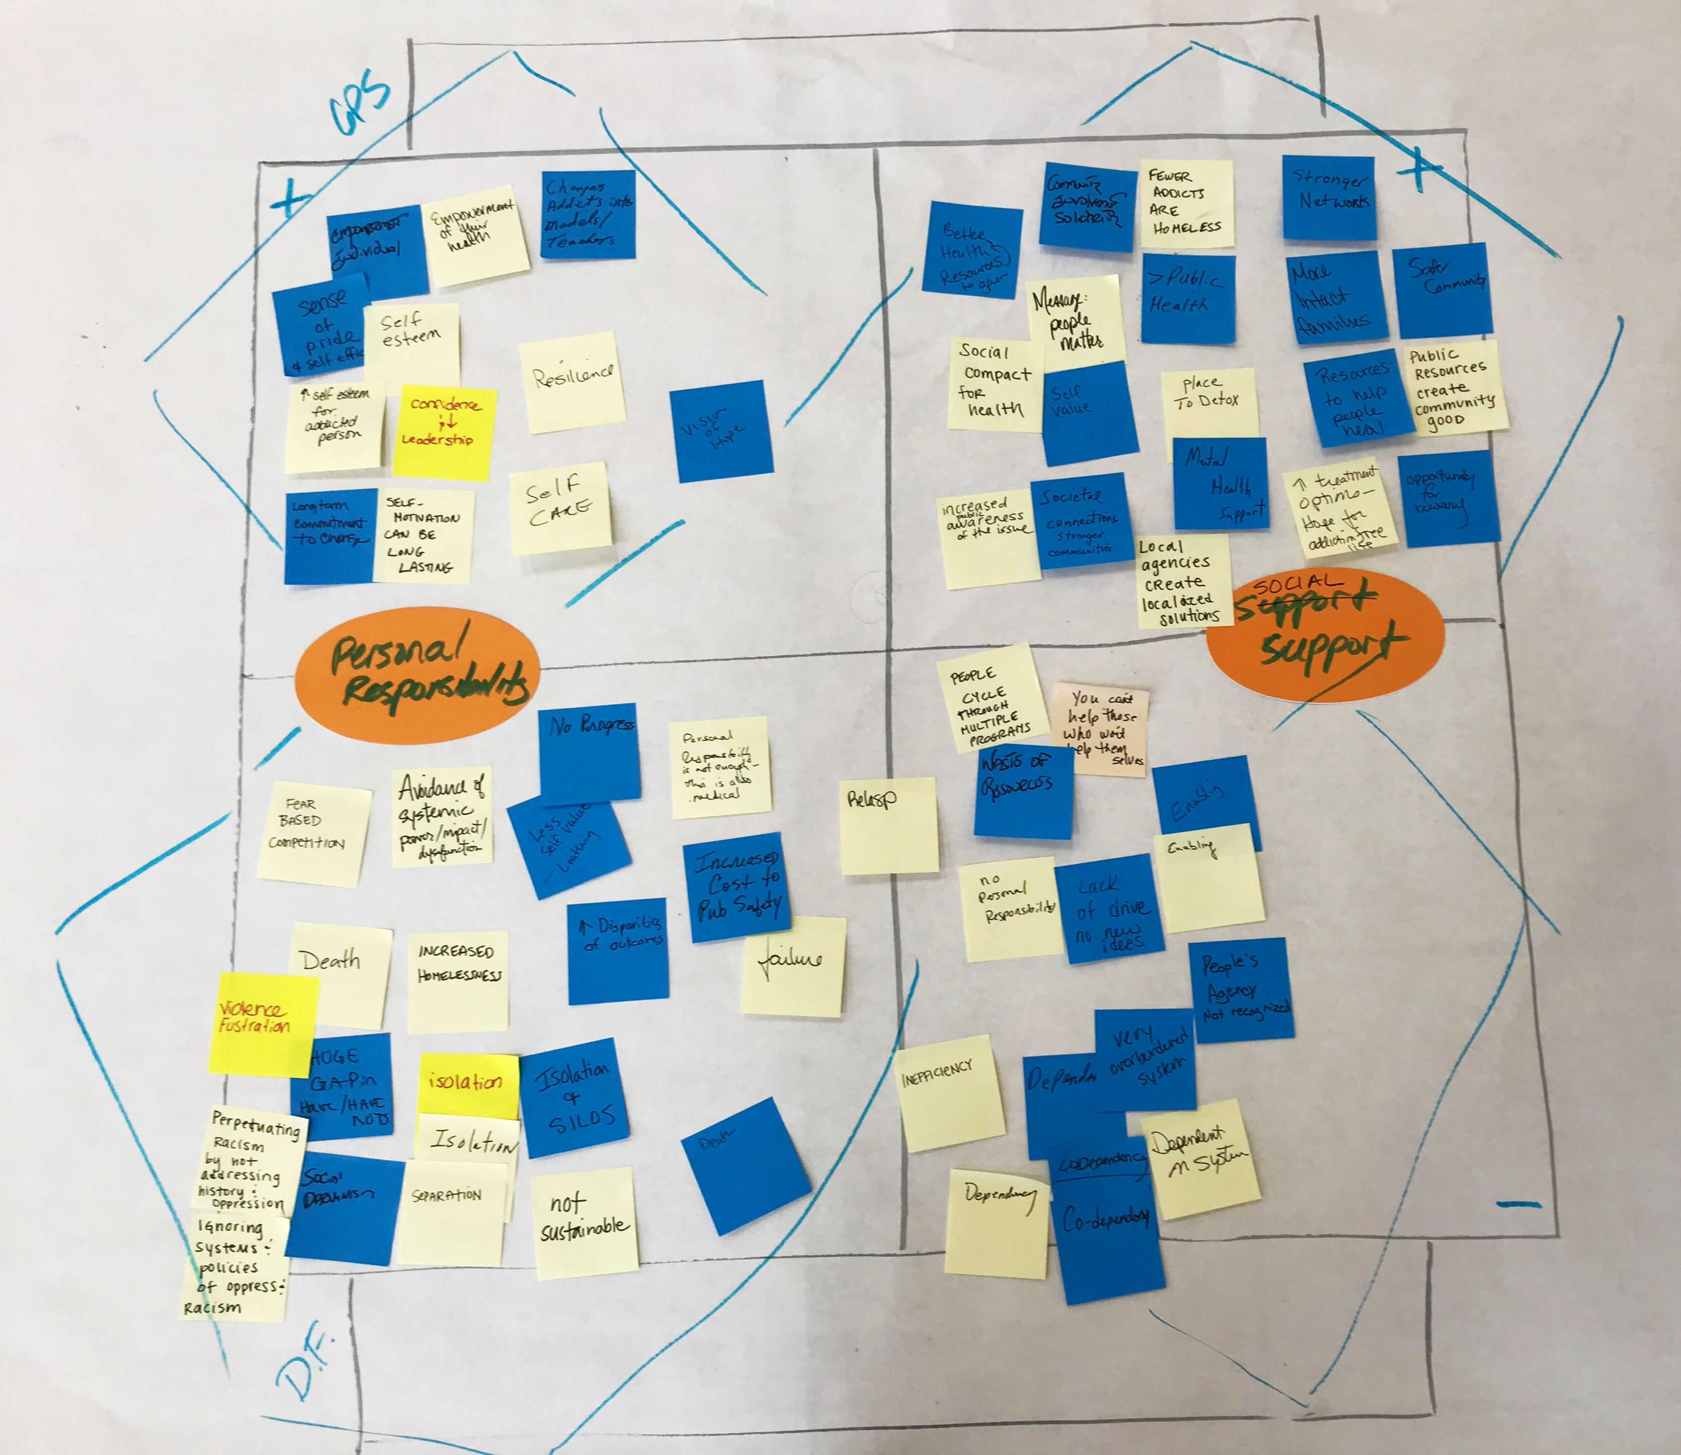

Slide 12
Confusion
Clarity
AND
Notes:
Nancy: I love flexibility. I get so many benefits from being open and flexible and having options. Raise your hand if you’re with me.
Luke: Nancy, may I interrupt?
Relates to voluntary initiatives and consistent national policy. In some ways, we need both, like breathing.

Slide 13
Flexibility
Clarity
AND
Notes:
Nancy: I love flexibility. I get so many benefits from being open and flexible and having options. Raise your hand if you’re with me.
Luke: Nancy, may I interrupt?
Relates to voluntary initiatives and consistent national policy. In some ways, we need both, like breathing.

Slide 14
Acting
Over-Analyzing
AND

Slide 15
Acting
Analyzing
AND

Slide 16
A Thriving, Successful Solution
Adapt to changing world
New energy and direction
Creativity
Leverage new wisdom
People feel honored for their creativity
Change
Stagnation
Loss of energy
Missed opportunities
Get left behind
Change agents are denigrated
Failed Solution

Slide 17
A Thriving, Successful Solution
Building from core Values
Honoring traditions
Continuity
Leverage past and present wisdom
People feel honored for their experience
Stability
Lose continuity
Lose core values
Foolish risk
People feel lost
Traditionalists are denigrated
Failed Solution

Slide 18
A Thriving, Successful Solution
Building from core Values
Honoring traditions
Continuity
Leverage past and present wisdom
People feel honored for their experience
Adapt to changing world
New energy and direction
Creativity
Leverage new wisdom
People feel honored for their creativity
Stability
Change
and
Stagnation
Loss of energy
Missed opportunities
Get left behind
Change agents are denigrated
Lose continuity
Lose core values
Foolish risk
People feel lost
Traditionalists are denigrated
Failed Solution

Slide 19
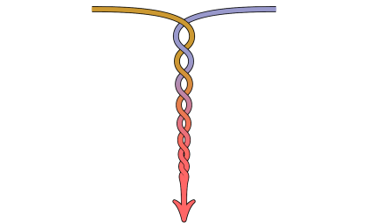
A Thriving, Successful Solution
Building from core Values
Honoring traditions
Continuity
Leverage past and present wisdom
People feel honored for their experience
Adapt to changing world
New energy and direction
Creativity
Leverage new wisdom
People feel honored for their creativity
Stability
Change
or
Stagnation
Loss of energy
Missed opportunities
Get left behind
Change agents are denigrated
Lose continuity
Lose core values
Foolish risk
People feel lost
Traditionalists are denigrated
Failed Solution

Slide 20
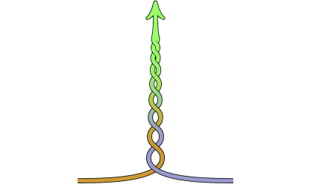
A Thriving, Successful Solution
Building from core Values
Honoring traditions
Continuity
Leverage past and present wisdom
People feel honored for their experience
Adapt to changing world
New energy and direction
Creativity
Leverage new wisdom
People feel honored for their creativity
Stability
Change
and
Stagnation
Loss of energy
Missed opportunities
Get left behind
Change agents are denigrated
Lose continuity
Lose core values
Foolish risk
People feel lost
Traditionalists are denigrated
Failed Solution

Slide 21
A Thriving, Resilient Democracy
Innovation and entrepreneurship
You keep what you earn
Individual opportunity
Take care of one another
Shared resources are protected
Opportunity for all
Self-interest
Common Good
and
Increasing discrepancies between haves and have-nots
Exploitation of common resources
Opportunity for privileged few
Passivity and lack of initiative
Entitlement
Over-regulation
A Failing, Polarized “Democracy”

Slide 22
Tunnel Vision
A Thriving, Resilient Democracy
Take care of one another
Shared resources are protected
Opportunity for all
People who value the common good are repulsed by the downsides of self-interest. This is the direction of their energy.
Common Good
Increasing discrepancies between haves and have-nots
Exploitation of common resources
Opportunity for privileged few
A Failing, Polarized “Democracy”

Slide 23
Tunnel Vision
A Thriving, Resilient Democracy
Innovation and entrepreneurship
You keep what you earn
Individual opportunity
People who value self-interest are are also repulsed by the downsides of focusing on the common good. This is the direction of their energy.
Self-interest
Passivity and lack of initiative
Entitlement
Over-regulation
A Failing, Polarized “Democracy”

Slide 24
Liberal Stereotypes
A Thriving, Resilient Democracy
“Responsible!”
Take care of one another
Shared resources are protected
Opportunity for all
“Just!”
“Compassionate”
Self-interest
Common Good
or
Increasing discrepancies between haves and have-nots
Exploitation of common resources
Opportunity for privileged few
“Greedy”
“Selfish”
“Fascists”
A Failing, Polarized “Democracy”

Slide 25
Conservative Stereotypes
A Thriving, Resilient Democracy
“Patriotic!”
Innovation and entrepreneurship
You keep what you earn
Individual opportunity
“Job Creators”
“Protecting our Freedoms”
Self-interest
Common Good
or
Passivity and lack of initiative
Entitlement
Over-regulation
“Snowflake”
“Moocher”
“Bleeding Heart Hippies”
A Failing, Polarized “Democracy”

Slide 26
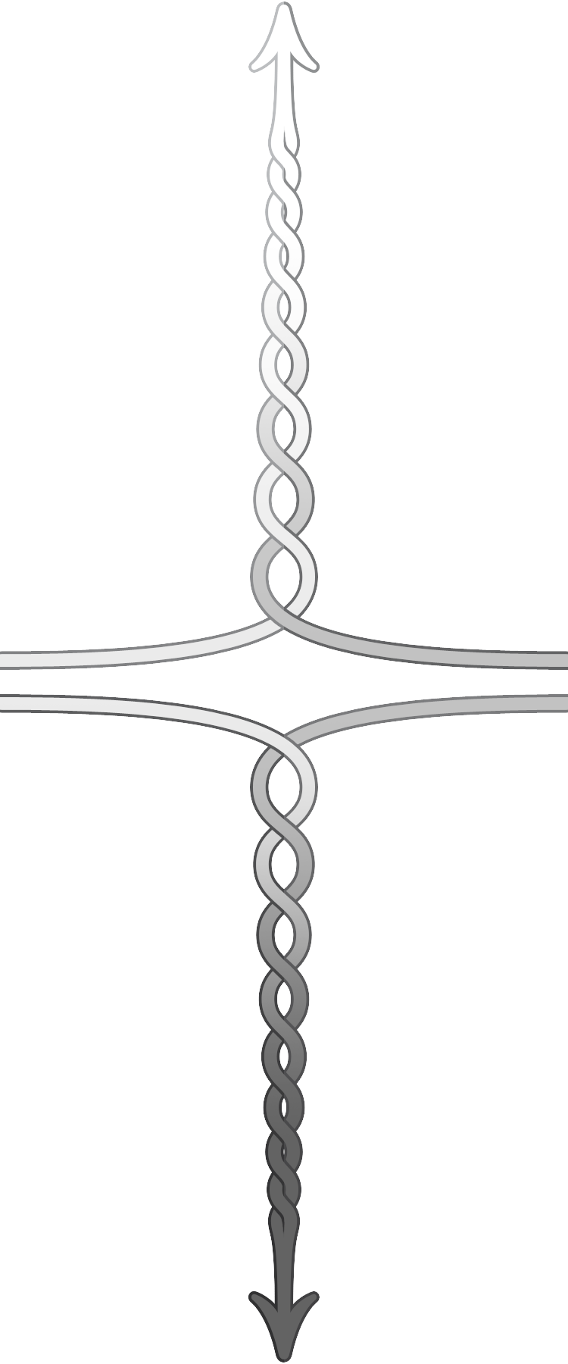
Action steps & Early warning signs
Greater Purpose Statement: Why leverage this tension?
Action Steps
How will we gain or maintain the positive results from focusing on this left pole? What? Who? By When?
Action Steps
How will we gain or maintain the positive results from focusing on this right pole? What? Who? By When?
Values = positive results of focus on the left pole
Values = positive results of focus on the right pole
and
Early Warnings
Measurable indicators that will let you know that you are getting into the downside of this left pole.
Early Warnings
Measurable indicators that will let you know that you are getting into the downside of this right pole.
Fears = negative results of over-focus on the left pole to the neglect of the right pole
Fears = negative results of over-focus on the right pole to the neglect of the left pole
Deeper Fear from not seeing and optimizing the tension

Slide 27
A Thriving, Resilient Democracy
Because our current preference has real value:
We can easily adapt
We create new solutions
We can make decisions
We can act when needed
We feel like owners
What we really want:
We do what we say
We meet our performance goals
We execute on our plans
We’re maximizing resources
We can trust each other’s word
Freedom
Responsibility
and
What’s wrong around here:
We’re all over the place
People are just making stuff up
We have no plan
Things aren’t getting done
We’re wasting resources
People shoot from the hip
Oh, but if we go too far…
We’re stifled
We feel less ownership
There’s no room for creativity
We can’t change quickly
People are too controlling
A Failing, Polarized “Democracy”

Slide 28
Experiencing interdependence
THRIVE
GREAT!
Release Carbon Dioxide
Get Oxygen
OKAY
Inhale
Exhale
and
BAD!
Too Much Carbon Dioxide
Not Enough Oxygen
DIE
Based on the work of Polarity Partnerships, LLC

Slide 29
More learning, tools, and resources
Free tools and materials on our website:
www.cocreativeconsulting.com/tools
And we’d love to hear from you!
talktous@cocreativeconsulting.com
Don’t forget to send us a tweet!
@WeAreCocreative
Training courses:
Collaborative Innovation Essentials (DC, Seattle, & Oakland)
Collaborative Leadership Essentials (DC & Oakland)
Leveraging Conflict for Innovation
Design & Systems Thinking for Transformational Change
Advanced Collaborative Leadership

