Slide 1
Shifts, Ideas, and Prototypes Moving from Insight to Action
www.cocreativeconsulting.com

Slide 2
Who we are
CoCreative helps people who don’t know each other (and often don’t even like each other) solve complex problems and create better futures together.
We work across sectors and industries, in public policy, development, energy, food, education, leveraging deep partnerships to create more thriving and resilient social systems.
We do this by designing and supporting collaborative innovation networks and collaborative strategy for high-impact social ventures.

Slide 3
LANDSCAPE MAP (Review & Validate)
SHIFTS (Generate & Prioritize)
IDEAS (Generate & Choose)
CONCEPTS (Develop & Test)
PROTOTYPES (Build & Test)
LEARN
ADAPT
TEST
PILOTS
SOLUTIONS

Slide 4
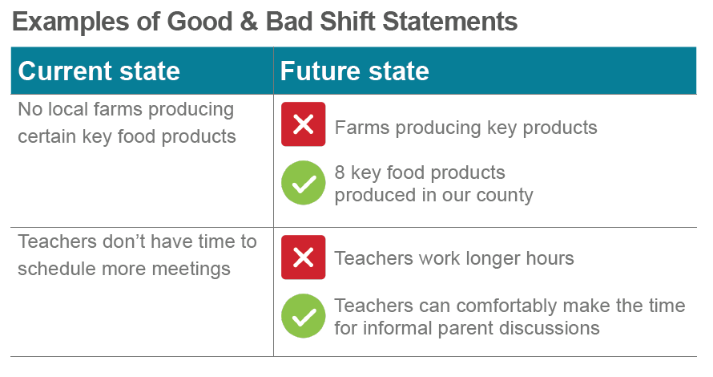
Developing Critical Shifts

Slide 5
What a Shift Is…and Isn’t
A Shift is…
a WHAT statement comprised of (1) what things look like now in a part of the system, and (2) what that part of the system needs to look in the future to achieve our goal.
Simply put: “Here’s what’s happening now and here’s what that should look like in the future.”
A Shift is not…
a problem-solution statement or an assertion about HOW we would achieve the future state.

Slide 6
Reflection Questions for Identifying Key Shifts
A good shift statement creates an invitation to start generating and designing ideas to make the shift happen.
A bad shift statement either confuses people (because it’s too vague) or shuts down a effective brainstorming (e.g. because it already contains a proposed solution).
A shift can be organization-level, community-level, industry-level, or policy-level.

Slide 7
Reflection Questions for Identifying Key Shifts
What issue is most impairing progress toward our goal?
What most needs to change in terms of advancing equity in job access, workforce development, and employment?
Where might we do a relatively small but high-leverage intervention that would produce real momentum?
Where might the National Fund play a pivotal role in driving systems change?
What’s already working with the National Fund’s work that we want to expand or extend?

Slide 8
Critical Shifts
Why they are useful…
Help us to agree on the problem and intervention areas before jumping to potential solutions.
Provide a strategic way to identify the most critical leverage points to maximize social return on investment.
Provide a clear problem-solving space to focus the development of solutions.
Help avoid favored solutions by focusing on the needs first.
Provide a basis to evaluate possible solutions over time, and avoid solutions that aren’t paying off.

Slide 9
Idea Prioritization Factors
Feasible
We can initiate it and build progress quickly in the next 6 months.
Shift-specific
Will make your critical shift happen in a powerful way.
High-leverage
Doing this first will enable other strategies to work.
Relevant to all Geographies
Relevant across all levels of the tri-County region.
Human-Centered
Changes the experience of those most impacted by disparities in the system (racism, poverty, ableism)
Cross- Sector
Can meaningfully engage multiple sectors that are at the table in this network.

Slide 10
Reflection Questions
What issue is impacting the food security of the most people?
What barrier if we removed it would make the biggest difference?
What segment of our population is being most severely impacted by food insecurity?
In what area could we get a quick win? (A relatively small intervention that would produce real momentum.)

Slide 11
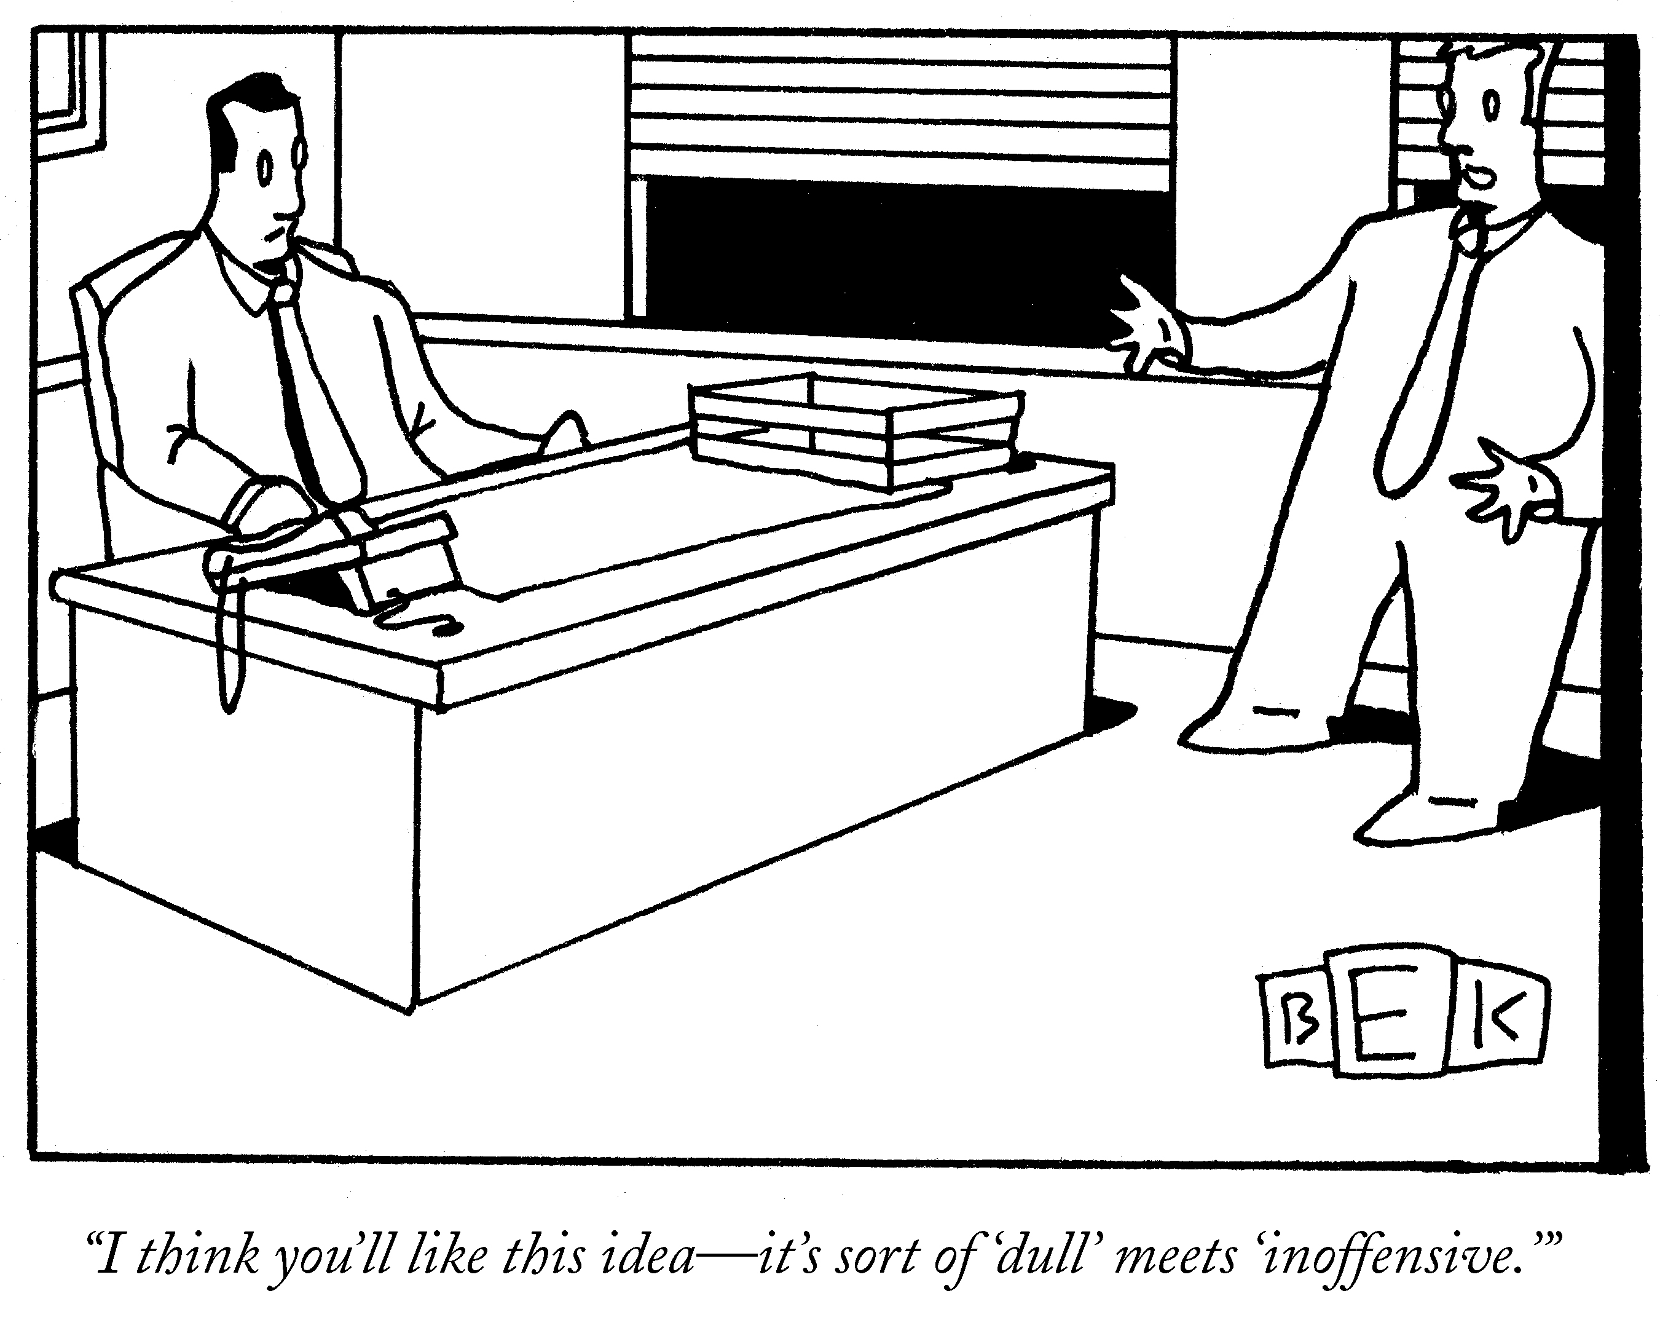
A Bad Idea
Bruce Eric Kaplan The New Yorker Collection The Cartoon Bank

Slide 12
What an Idea Is…and Isn’t
An Idea is…
a concrete action (programs, services, initiatives, etc.) that can be take toward a specific outcome.
Example: “Get more architects elected to public office to ensure a ‘seat at the table’ on public design decisions.”
An Idea is not…
a statement about an issue, need, or a declaration or assertion about a challenge or opportunity. Example: “Architects need to have a seat at the table on public design decisions.”

Slide 13
4 Blockers to Good Brainstorming
Rabbit Holes Don’t get bogged down in discussion. Only discuss an idea enough to help clarify it, and no more.
Group Think Break away from the pattern of generating more of the same types of ideas, or just adding variations of a single central idea.
Perfectionism & Critique Ideas are fragile things and they die easily. Adding to an idea produces much better output than tearing it apart.
Being “Open” The most compelling ideas are specific and provocative. Avoid trying to make your ideas appealing by keeping them general and unspecific.

Slide 14
Idea Examples
Feeds aren’t formulated to use small grains
Feeds incorporate small grains as a matter of course
Helpful Ideas | Less Helpful Ideas
Host a learning event for feed formulators about using small grains Design pre-mixes using small grains to reduce rail costs | Convince companies to use more small grains (vague) Talk to Cargill about using small grains in pre-mixes (task)

Slide 15
Generating Ideas
Helpful constraints: A powerful idea will…
Will make your key shift happen in a powerful way
Is concrete and specific
Can be piloted within 3-6 months
Wouldn’t happen without us

Slide 16
6 Reasons to Prototype
Communication. Helps ensure that everyone involved is working from the same picture of the problem and solution.
Risk Mitigation. Helps reduce risk from missed requirements and expectations, and minimizes cost overruns.
Decision-making. Helps make decisions faster and more clearly.
Learning. Contributes to grounded, focused learning about the real needs and requirements for the solution.
Testing Feasibility and Desirability with key stakeholders before investing further.
Building Support for Your Solution. People tend to support solutions that are real and tangible, not imaginary.

Slide 17
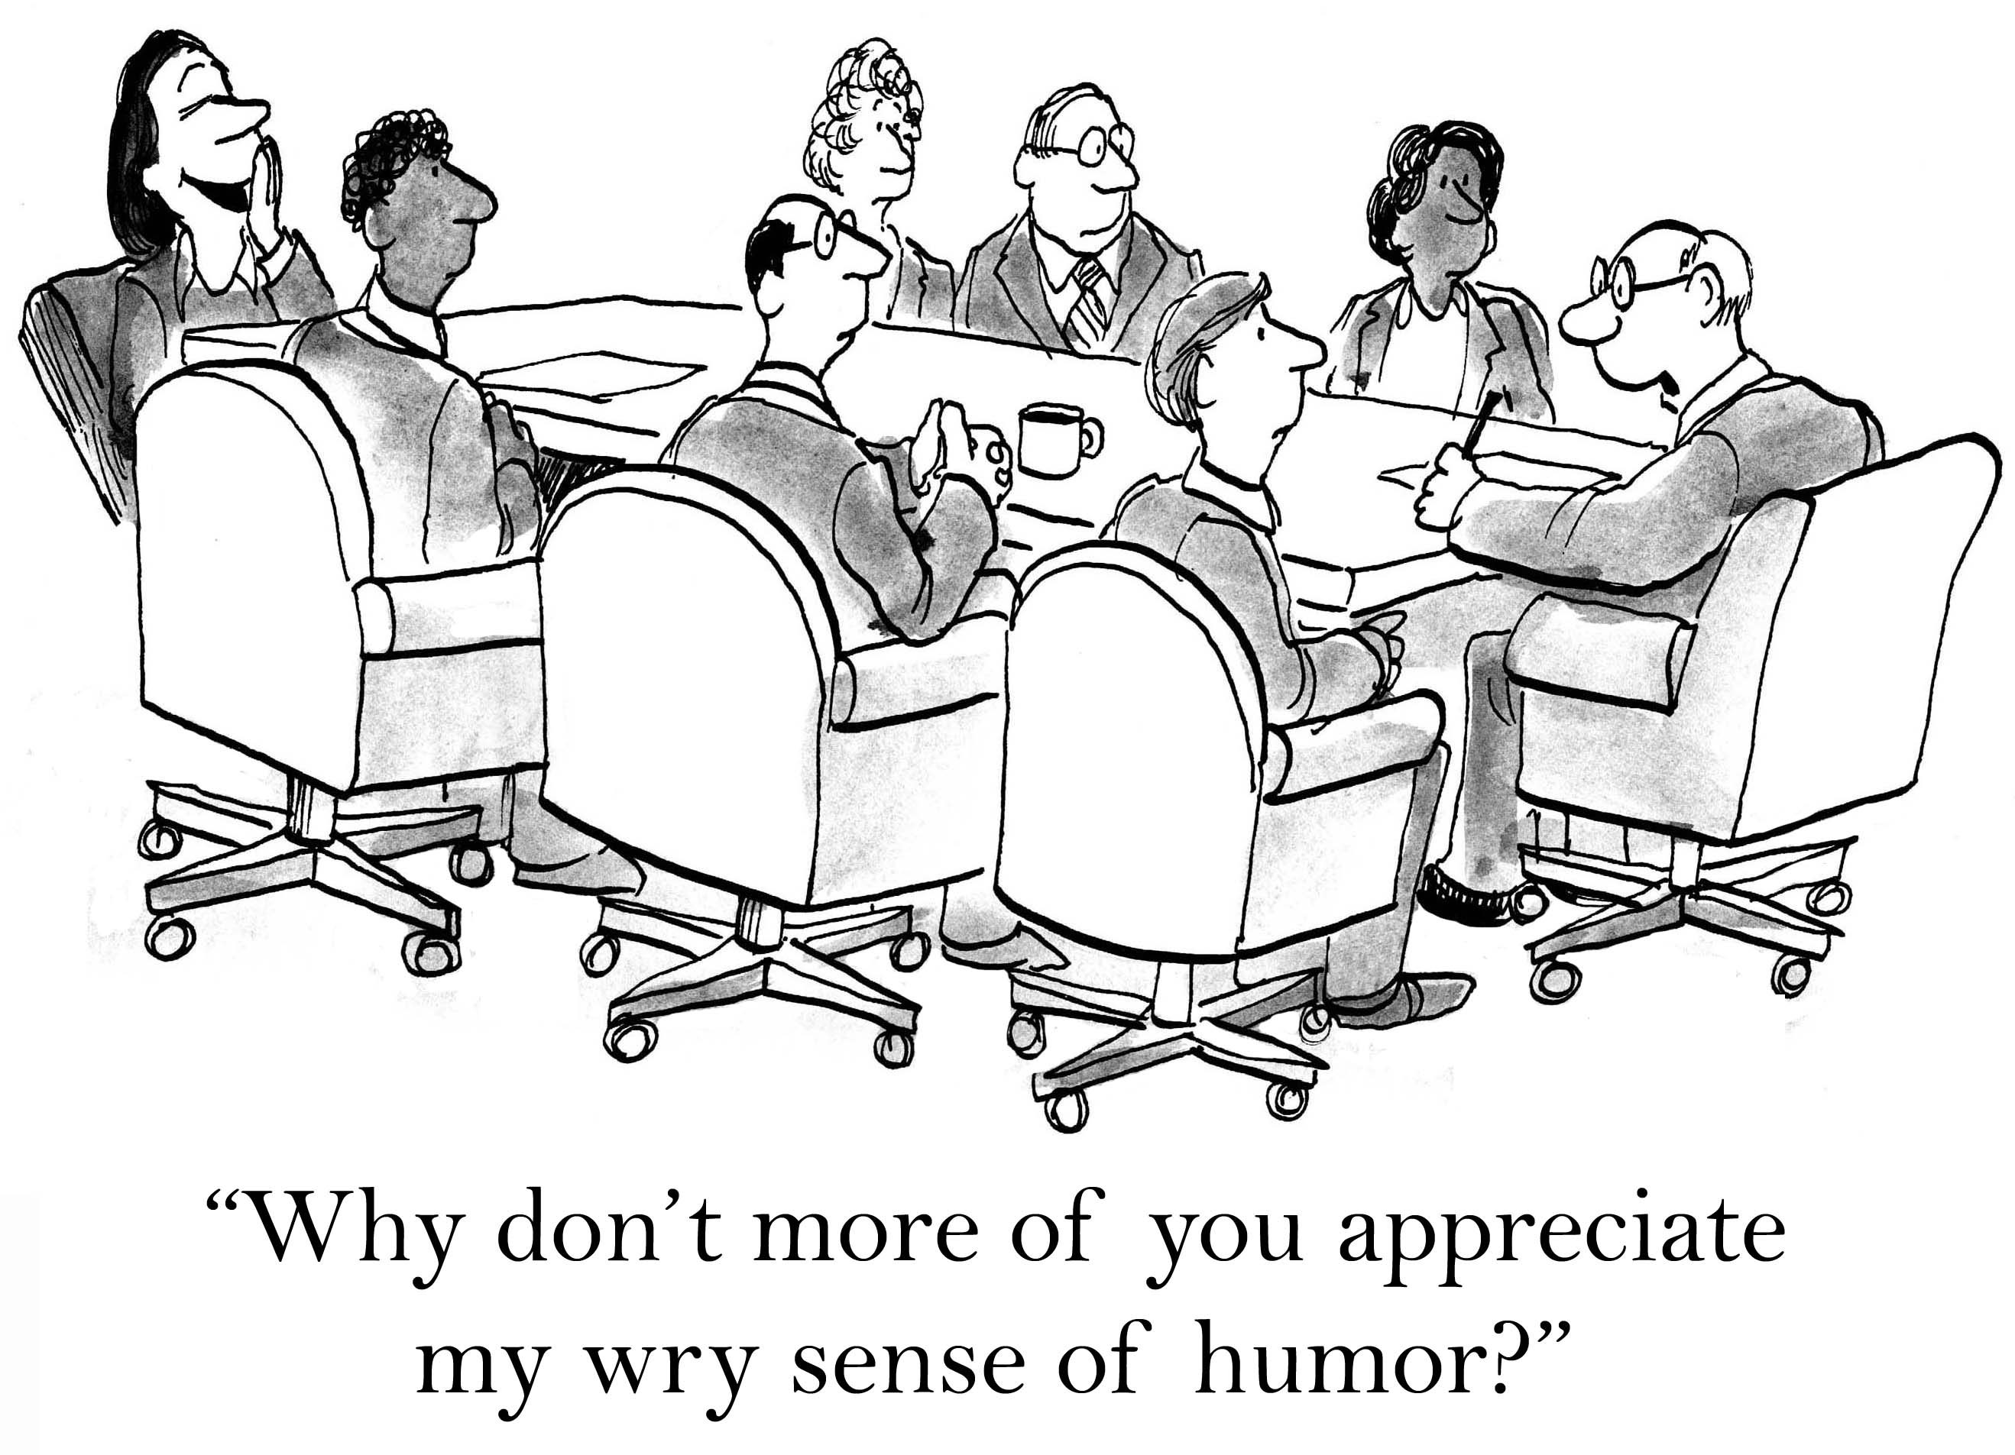
!
?
Communication

Slide 18
How to prototype BMX tricks, without getting hurt (too badly).
Risk Mitigation

Slide 19
In 2012, 10,000 parents and teenagers met across 3 cities to prototype a policy platform to support their success.
The process took 90 minutes.
Decision-making

Slide 20
Prototyping helps us learn (and fail) fast so we don’t waste time and money in understanding what people really need.
Learning

Slide 21
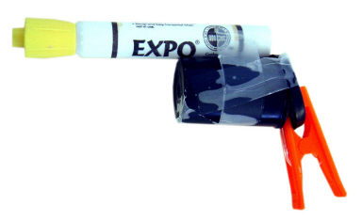
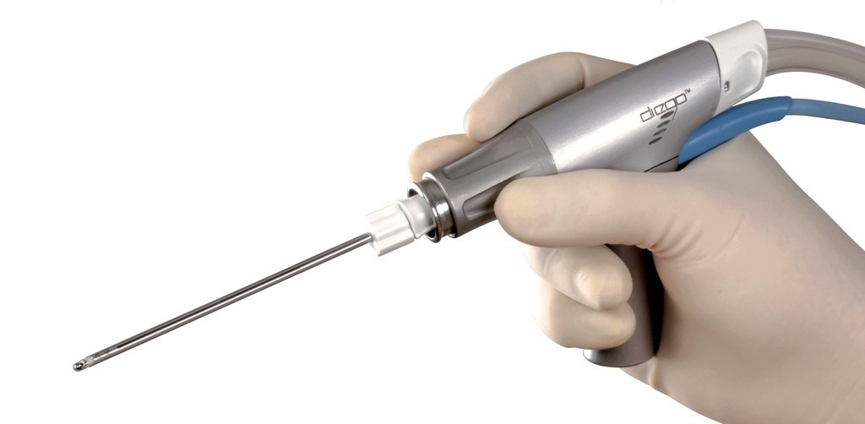
1. Get Tangible, Fast
Rough | Rapid | Right
Good enough, any materials, no emotional attachment | Iterate many options quickly, efficient and cheap, instant feedback | Be clear on what you want to learn, focus on high risk areas first, build only what’s necessary
© 2017 IDEO
© 2017 Olympus America

Slide 22
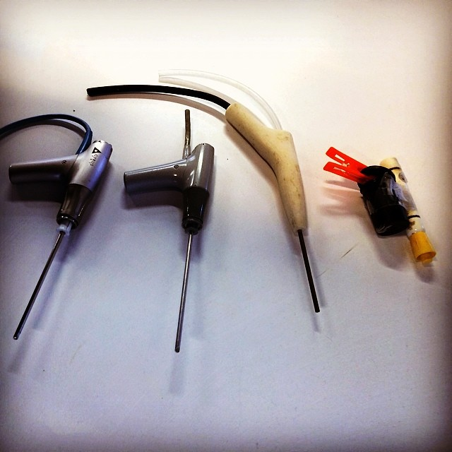
2. Align Technique with Purpose
Inspire (Lo-Fi)
Evolve
Validate (Hi-Fi)
Production

Slide 23
What a Prototype is NOT
A Plan to Do Something
“Here’s what we’re going to do…”
A Plan to Make Something
“We would develop a survey that would do X, Y, and Z.”
A Discussion of Possibilities
“The policy platform would be something that…”
Talking about the Thing
“Here’s a PowerPoint deck. On this slide, we would have this…”
WHEN PROTOTYPING:
DON’T PLAN IT.
DON’T DISCUSS IT.
DON’T TALK ABOU IT.
MAKE IT.

Slide 24
Produce a Concept and a Simple Prototype
Appoint a Facilitator & a Notetaker/Reporter
Complete the Concept Worksheet
Make a simple prototype to SHOW what you might make
Be ready to give a 3-minute presentation
You have 45 minutes

Slide 25
More learning, tools, and resources
Free tools and materials on our website:
www.cocreativeconsulting.com/tools
And we’d love to hear from you!
talktous@cocreativeconsulting.com
Don’t forget to send us a tweet!
@WeAreCocreative
Training courses:
Collaborative Innovation Essentials (DC, Seattle, & Oakland)
Collaborative Leadership Essentials (DC & Oakland)
Leveraging Conflict for Innovation
Design & Systems Thinking for Transformational Change
Advanced Collaborative Leadership

