Slide 2
Prototyping Essentials: For Innovation and Learning
www.cocreativeconsulting.com

Slide 3
Who we are
CoCreative helps people who don’t know each other (and often don’t even like each other) solve complex problems and create better futures together.
We work across sectors and industries, in public policy, development, energy, food, education, leveraging deep partnerships to create more thriving and resilient social systems.
We do this by designing and supporting collaborative innovation networks and collaborative strategy for high-impact social ventures.

Slide 4
6 Reasons to Prototype
Communication. Helps ensure that everyone involved is working from the same picture of the problem and solution.
Risk Mitigation. Helps reduce risk from missed requirements and expectations, and minimizes cost overruns.
Decision-making. Helps make decisions faster and more clearly.
Learning. Contributes to grounded, focused learning about the real needs and requirements for the solution.
Testing Feasibility and Desirability with key stakeholders before investing further.
Building Support for Your Solution. People tend to support solutions that are real and tangible, not imaginary.

Slide 5
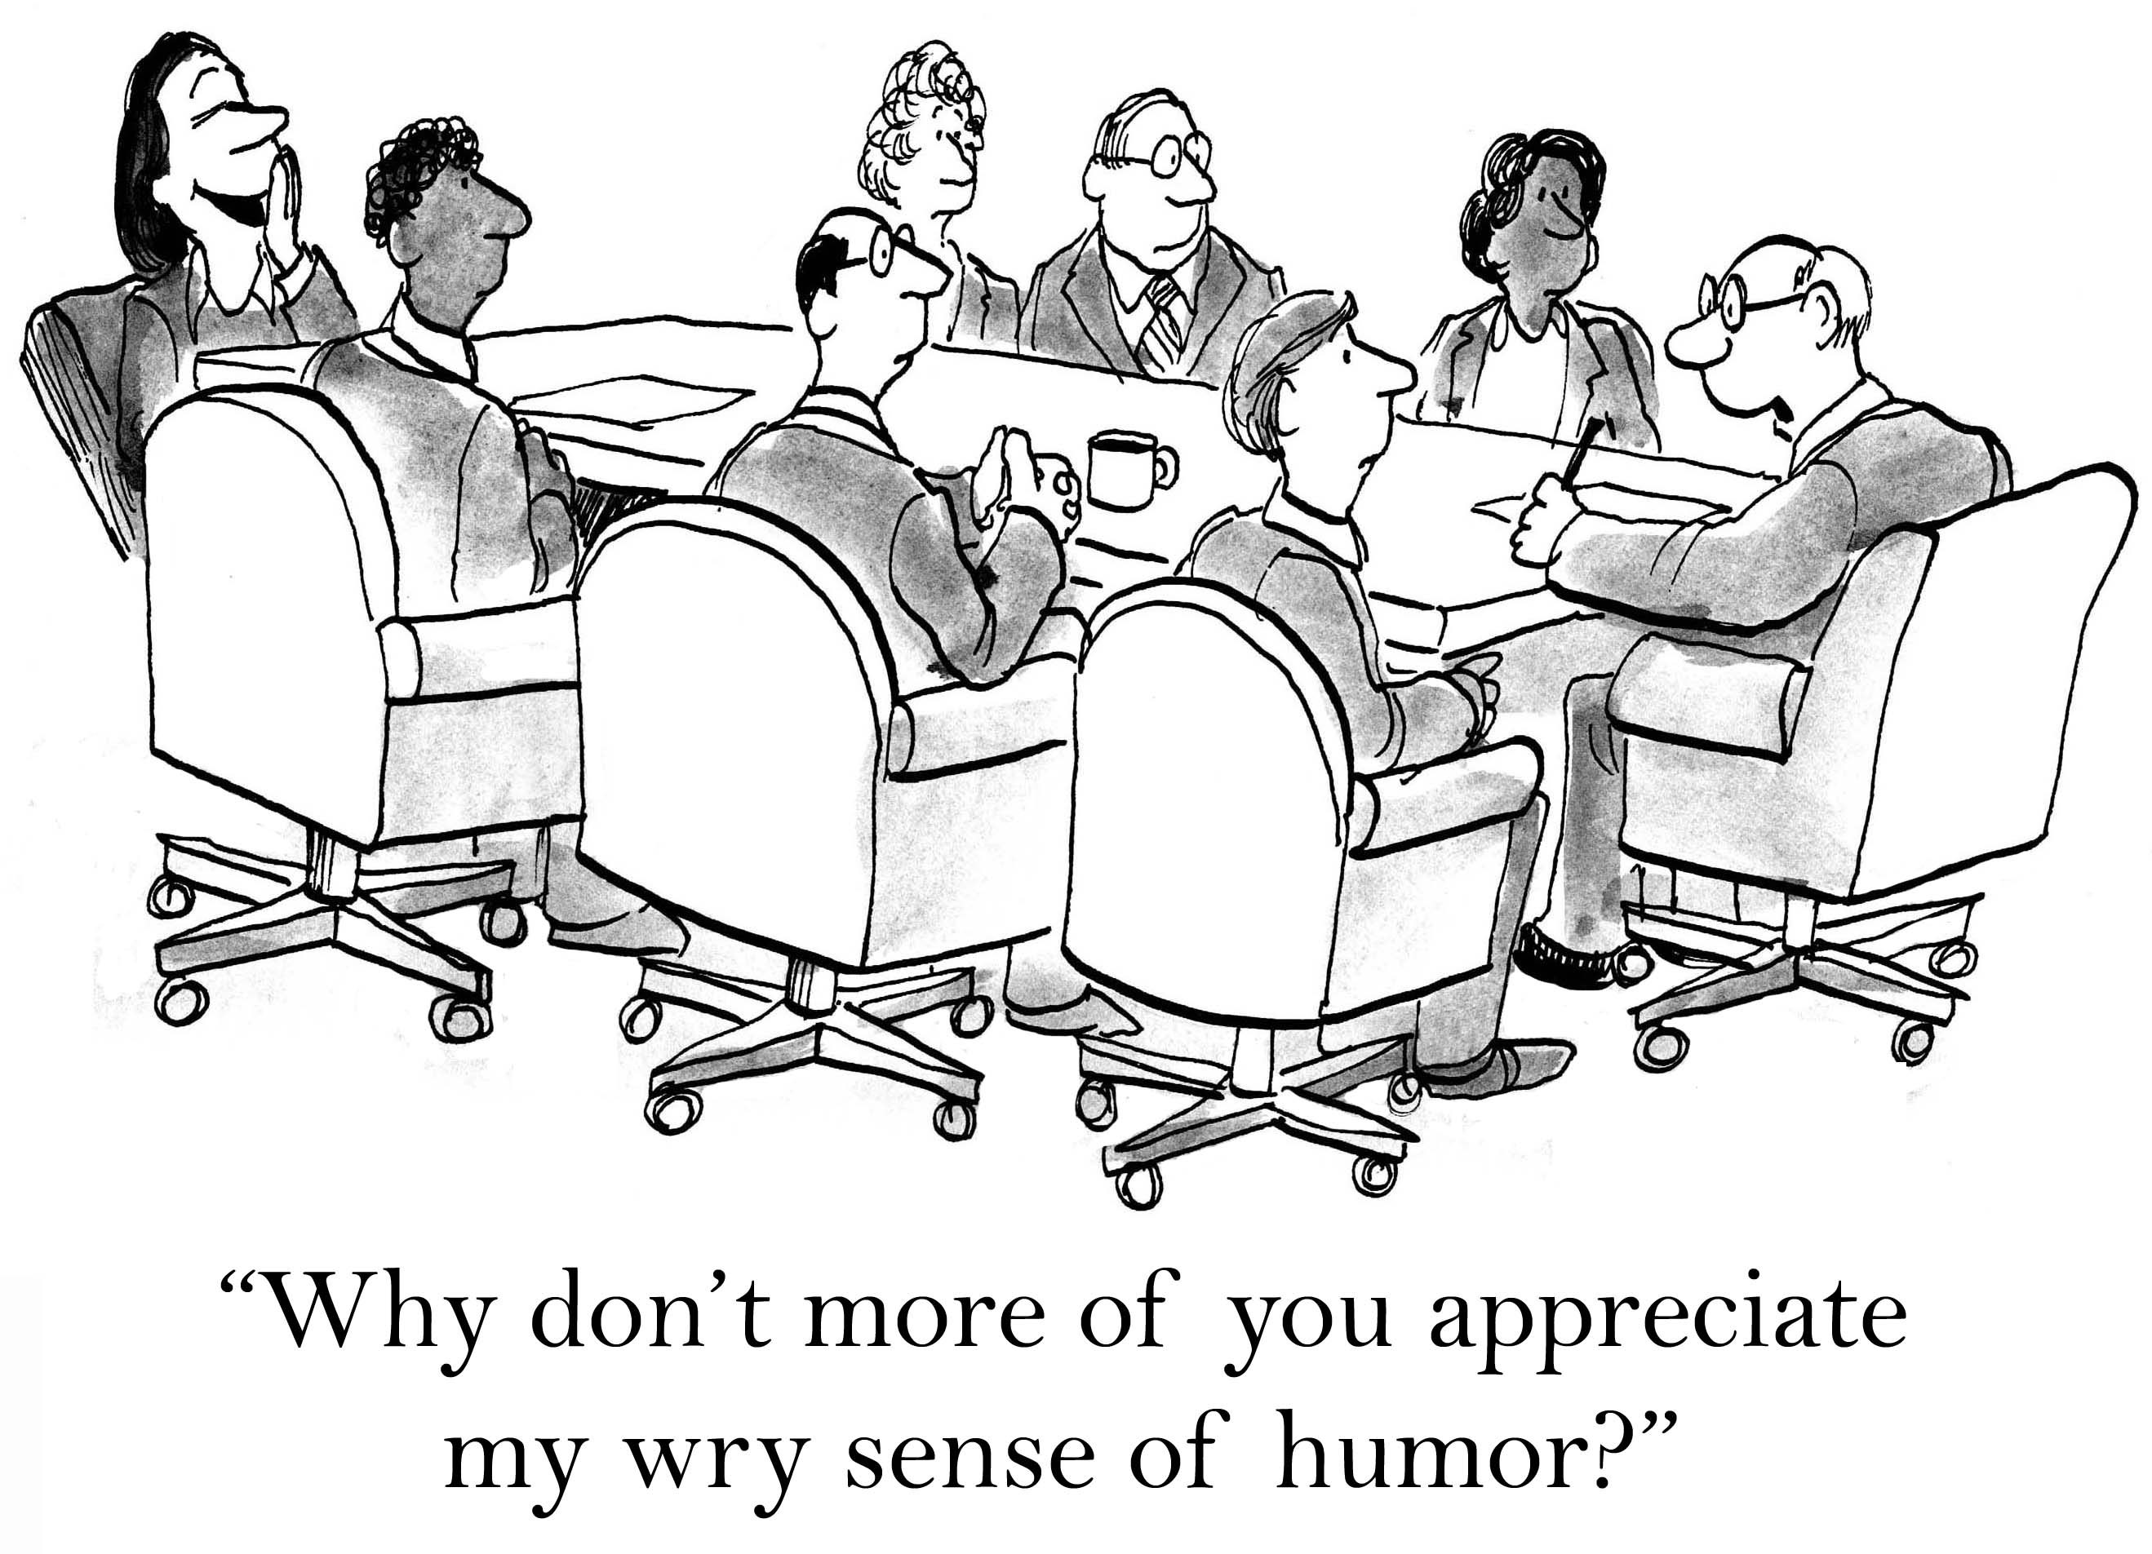
!
?
Communication

Slide 6
How to prototype BMX tricks, without getting hurt (too badly).
Risk Mitigation

Slide 7
In 2012, 10,000 parents and teenagers met across 3 cities to prototype a policy platform to support their success.
The process took 90 minutes.
Decision-making

Slide 8
Prototyping helps us learn (and fail) fast so we don’t waste time and money in understanding what people really need.
Learning

Slide 9
The Prototyping Cycle
ABSTRACT
Generating Ideas
Defining the problem
Prototyping
LEARN
MAKE
Understanding & Observing
Testing Prototypes
CONCRETE

Slide 10
SHOW, DON’T TELL
3 Principles of Prototyping (Laura Weiss)
1. Get Tangible, Fast
Rough: Good enough, any materials, no emotional attachment
Rapid: Iterate many options quickly, efficient and cheap, instant feedback
Right: Be clear on what you want to learn, focus on high risk areas first, build only what’s necessary
2. Design for the Intended User & “Use Context”
Experiential: Consider the human experience of engaging with your solution
Provocative: Stimulate creative thinking
Comprehensive: Investigate the entire ecosystem in which the solution will operate
3. Align Methods with Purpose
Inspire
Evolve
Validate

Slide 11
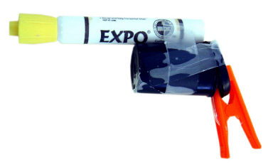
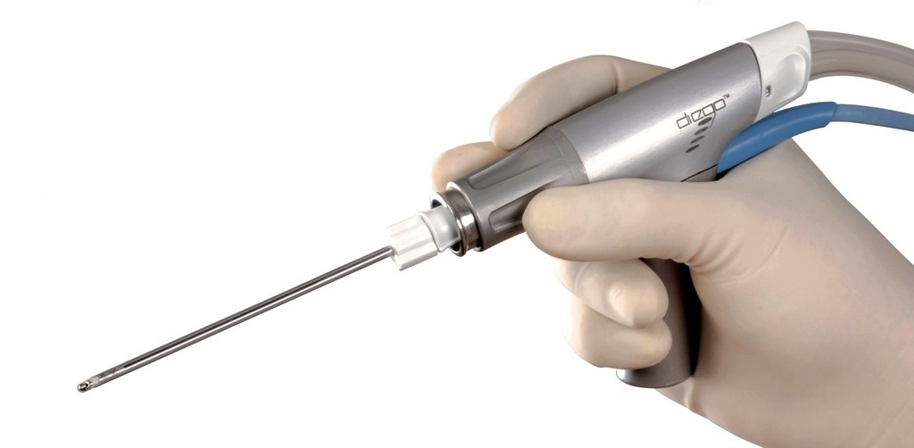
Principle #1 | Get Tangible, Fast
Rough | Rapid | Right
Good enough, any materials, no emotional attachment | Iterate many options quickly, efficient and cheap, instant feedback | Be clear on what you want to learn, focus on high risk areas first, build only what’s necessary
© 2017 IDEO
© 2017 Olympus America

Slide 12
Principle #3 | Align Technique with Purpose
Inspire (Lo-Fi)
Embrace failure
Build it yourself
Prototype to specify
Act to think
Draft criteria
Evolve
# ideas
Expect changes
Build it with an expert
Concept is partially specified
Isolate variables
Refine criteria
Validate (Hi-Fi)
One idea
Manage changes
Experts build it out
Concept is specified
time

Slide 13
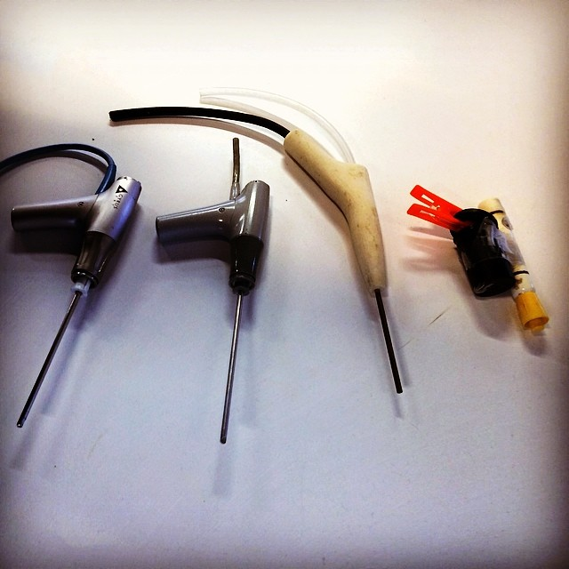
Principle #3 | Align Technique with Purpose
Inspire (Lo-Fi)
Evolve
Validate (Hi-Fi)
Production

Slide 14
6 Ways to Build Prototypes
Build a working example using Legos, KNEX construction kits, Lincoln Logs, or pipe cleaners
Make pretend materials with paper, tape, scissors and markers
Make a giant brochure using flipchart paper.
Create an interactive scene with peeps (with signs) or Little People (Fisher Price)
Produce a skit or scene using cardboard materials
Create a Journey Map (on whiteboard or paper) using storyboards to illustrate how the solution would work

Slide 15
What a Prototype is NOT
A Plan to Do Something
“Here’s what we’re going to do…”
A Plan to Make Something
“We would develop a survey that would do X, Y, and Z.”
A Discussion of Possibilities
“The policy platform would be something that…”
Talking About the Thing
“Here’s a PowerPoint deck. On this slide, we would have this…”
DON’T PLAN IT.
DON’T DISCUSS IT.
DON’T TALK ABOUT IT.
MAKE IT.

Slide 16
More learning, tools, and resources
Free tools and materials on our website:
www.cocreativeconsulting.com/tools
And we’d love to hear from you!
talktous@cocreativeconsulting.com
Don’t forget to send us a tweet!
@WeAreCocreative
Training courses:
Collaborative Innovation Essentials (DC, Seattle, & Oakland)
Collaborative Leadership Essentials (DC & Oakland)
Leveraging Conflict for Innovation
Design & Systems Thinking for Transformational Change
Advanced Collaborative Leadership

