Slide 1
Empathy Interviews:
Developing Insight for
Genuine Collaboration
www.cocreativeconsulting.com

Slide 2
Who we are
CoCreative helps people who don’t know each other (and often don’t even like each other) solve complex problems and create better futures together.
We work across sectors and industries, in public policy, development, energy, food, education, leveraging deep partnerships to create more thriving and resilient social systems.
We do this by designing and supporting collaborative innovation networks and collaborative strategy for high-impact social ventures.

Slide 3
Four Reasons to do Empathy Interviews
Insight
Get a more accurate view of the real needs, values, and aspirations of your stakeholders.
Perspective
Get out of your own head and experiences and gain new perspectives on both the problem and potential solutions.
Grounding
Ground your analysis and solution design in real human needs, not (just) theories and data.
Trust
Build trust through genuine inquiry and listening.

Slide 4
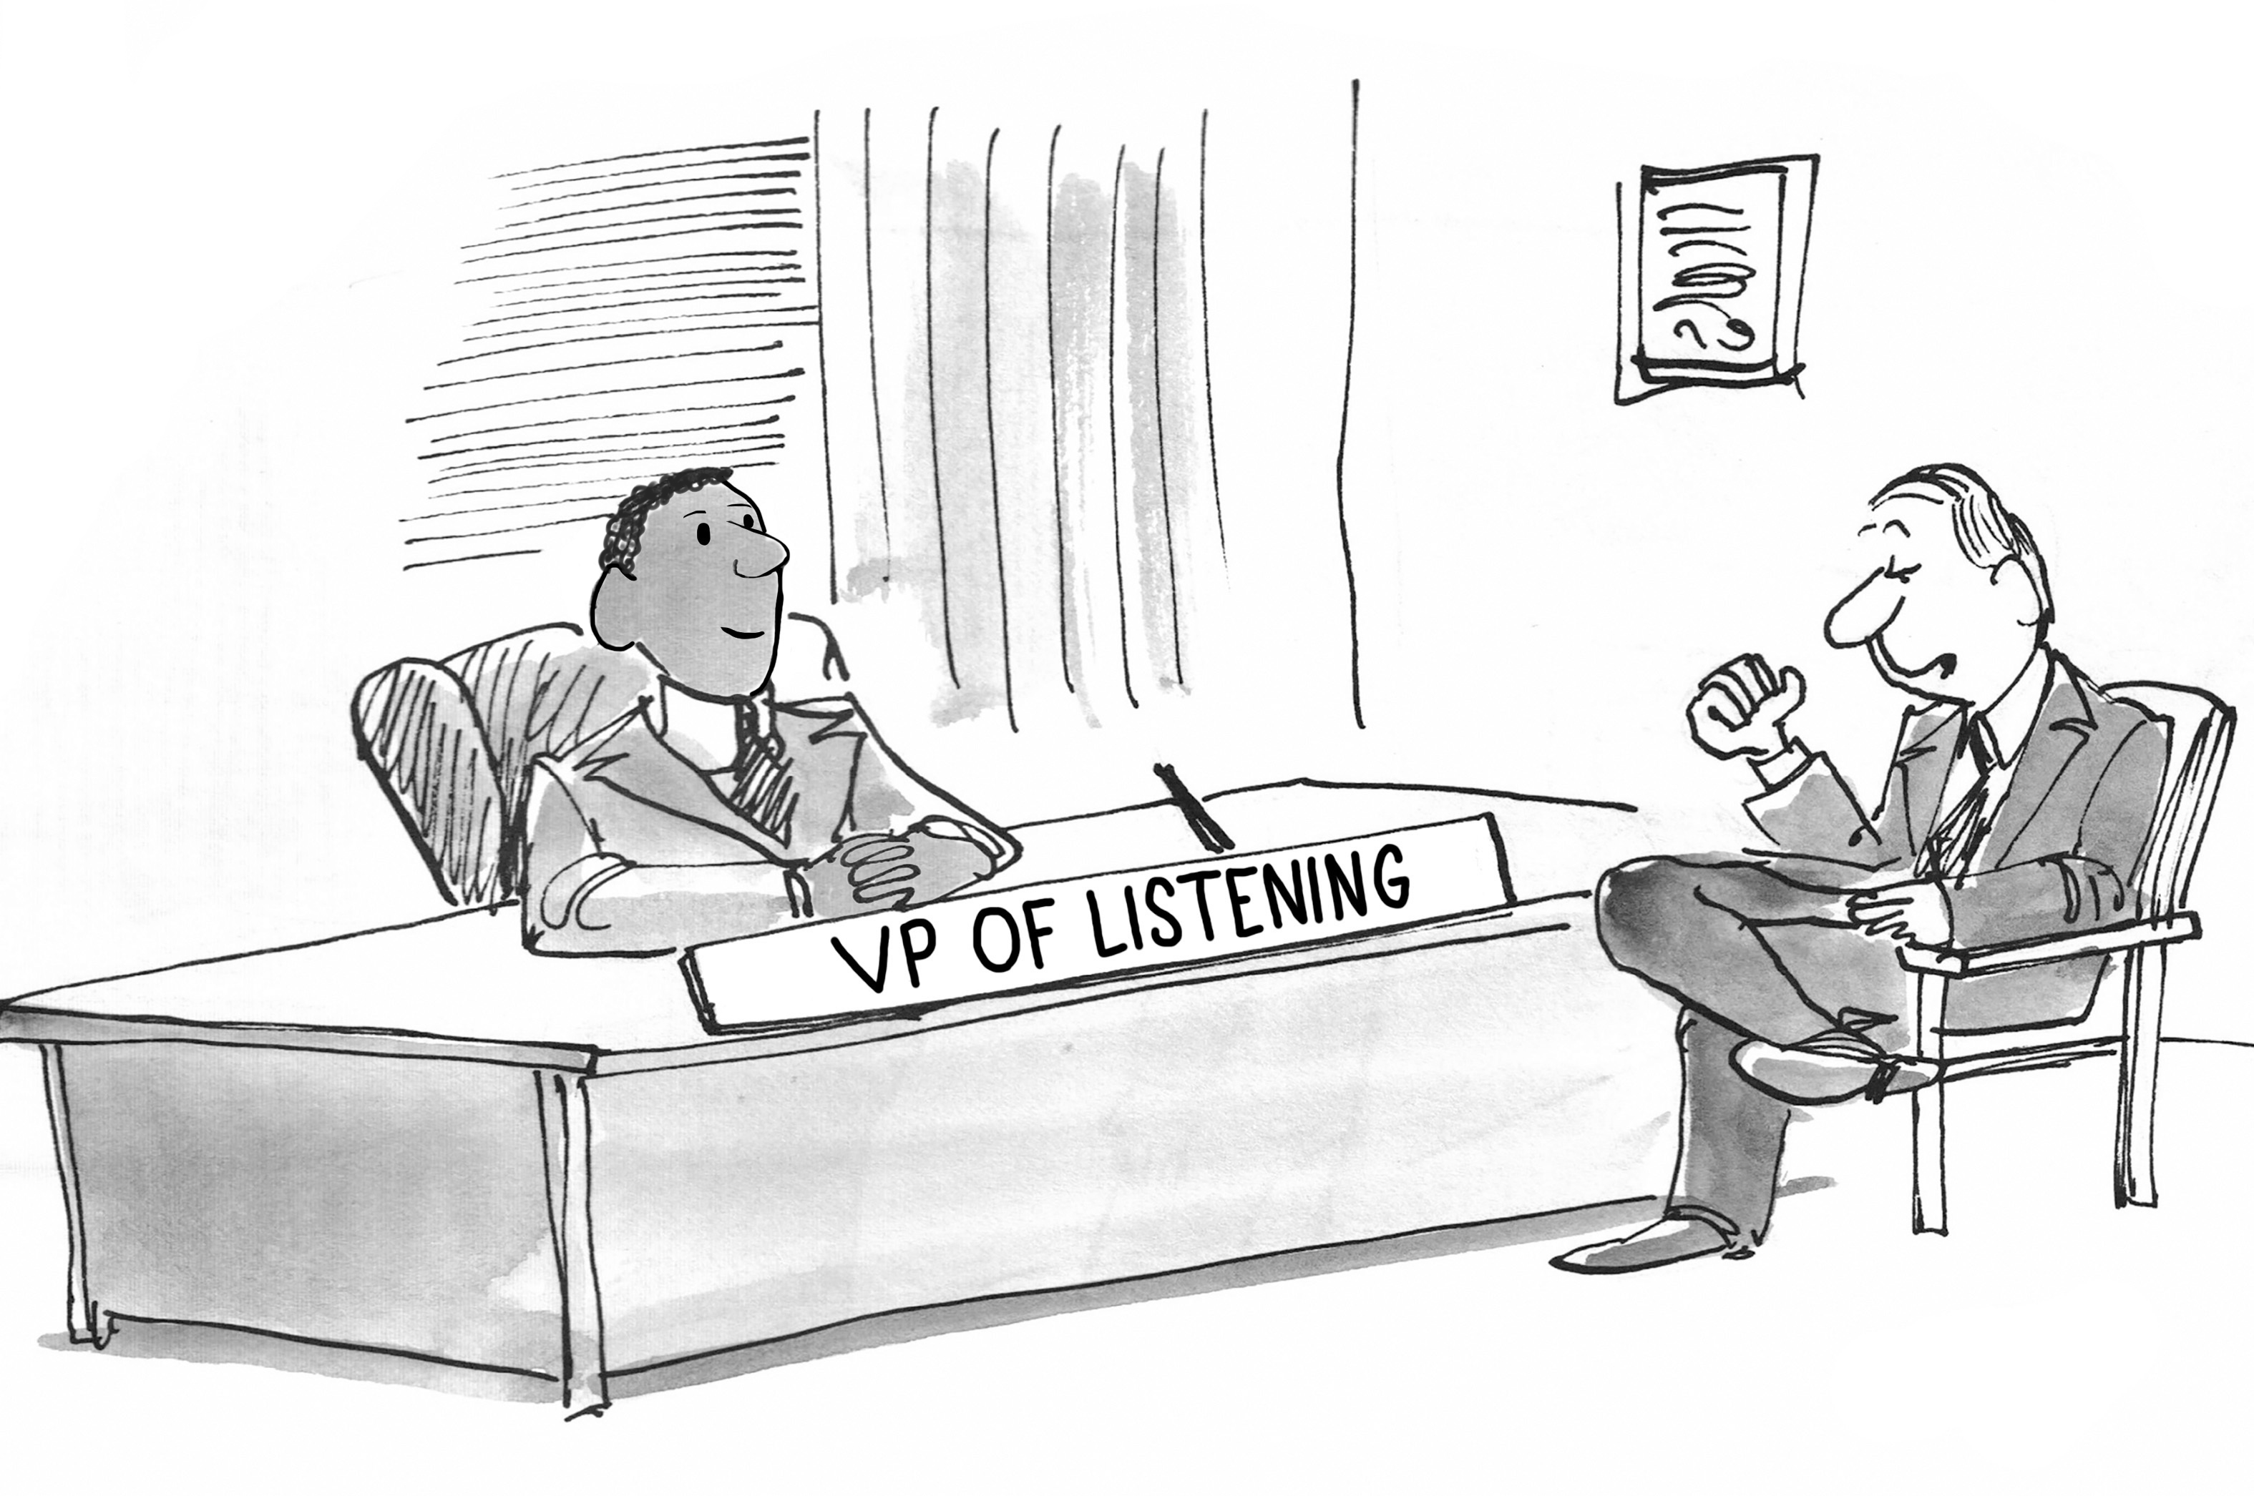
A New Role?

Slide 5
Four Types of Listening
Pretend Listening | Selective Listening | Attentive Listening | Empathetic Listening
Acting like you’re listening (but you’re actually distracted) | Listening as long as you like what you’re hearing. | Really listening, but judging, deciding, and advising. | Listening to understand. Curious and non-judgmental.
Listening inside your own
frame of reference.
Listening inside the other’s
frame of reference.
Adapted from Stephen R. Cover, 7 Habits of Highly Effective People

Slide 6
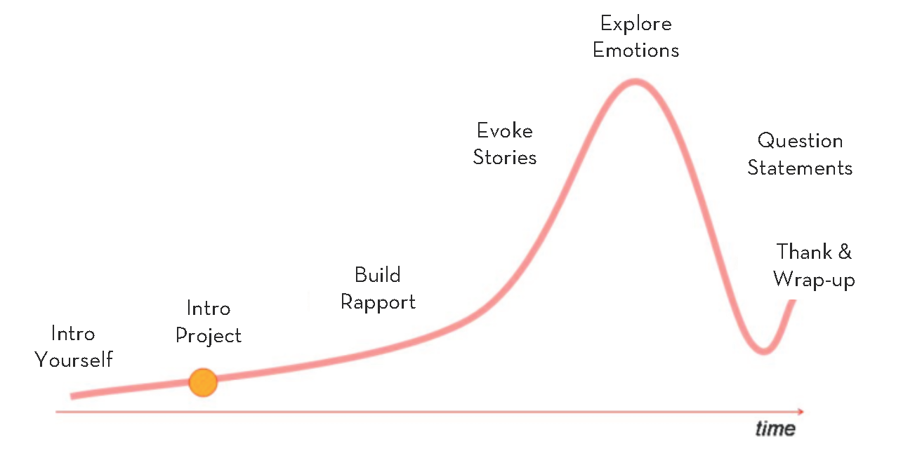
The Flow of a Conversation
Stanford d.school. Visual adapted from Michael Barry, Point Forward

Slide 7

“Say more...”
Never say “usually” or “normally”
when asking a question
Encourage stories
Don’t suggest answers to
your questions
Don’t be afraid of silence
Don’t ask binary questions
Ask questions neutrally
Ask about feelings
The Interviewer: Asking Questions

Slide 8
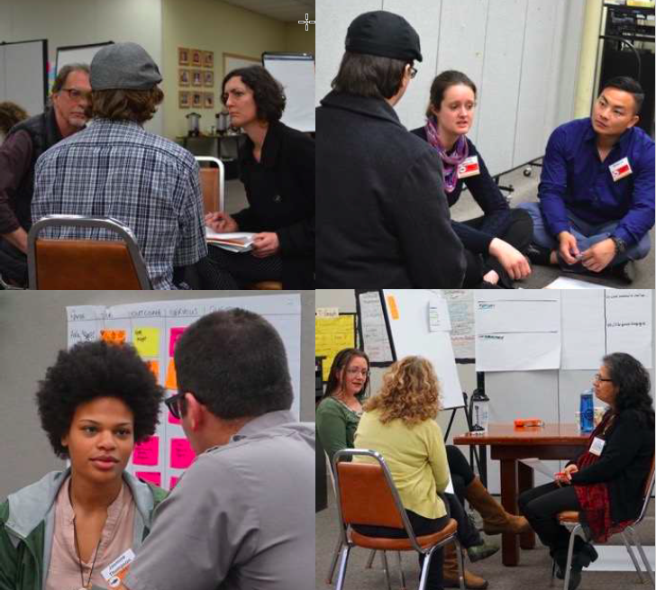
Lines of inquiry, not
giant question lists
Open questions
Use silence and neutral encouragement
Focus on their needs,
not solutions
Avoid leading questions or gestures
The Interviewer: Key Practices

Slide 9
Pay attention to nonverbal cues
Look for inconsistencies
Hunt for the powerful quote
Make sure you’re prepared to capture notes
Pay attention to your own feelings (e.g. surprise)
Be aware of your own cues
The Notetaker: Observing

Slide 10

Engaging Safely & Sensitively
Maintain privacy (e.g. use pseudonyms)
Arrange childcare if needed
Determine compensation
(but don’t assume)
Meet in a neutral, safe space (e.g. the person’s home if you and the person both feel safe and comfortable there)

Slide 11
More learning, tools, and resources
Free tools and materials on our website:
www.cocreativeconsulting.com/tools
And we’d love to hear from you!
talktous@cocreativeconsulting.com
Don’t forget to send us a tweet!
@WeAreCocreative
Training courses:
Collaborative Innovation Essentials
(DC, Seattle, & Oakland)
Collaborative Leadership Essentials
(DC & Oakland)
Leveraging Conflict for Innovation
Design & Systems Thinking for
Transformational Change
Advanced Collaborative Leadership

