Slide 1
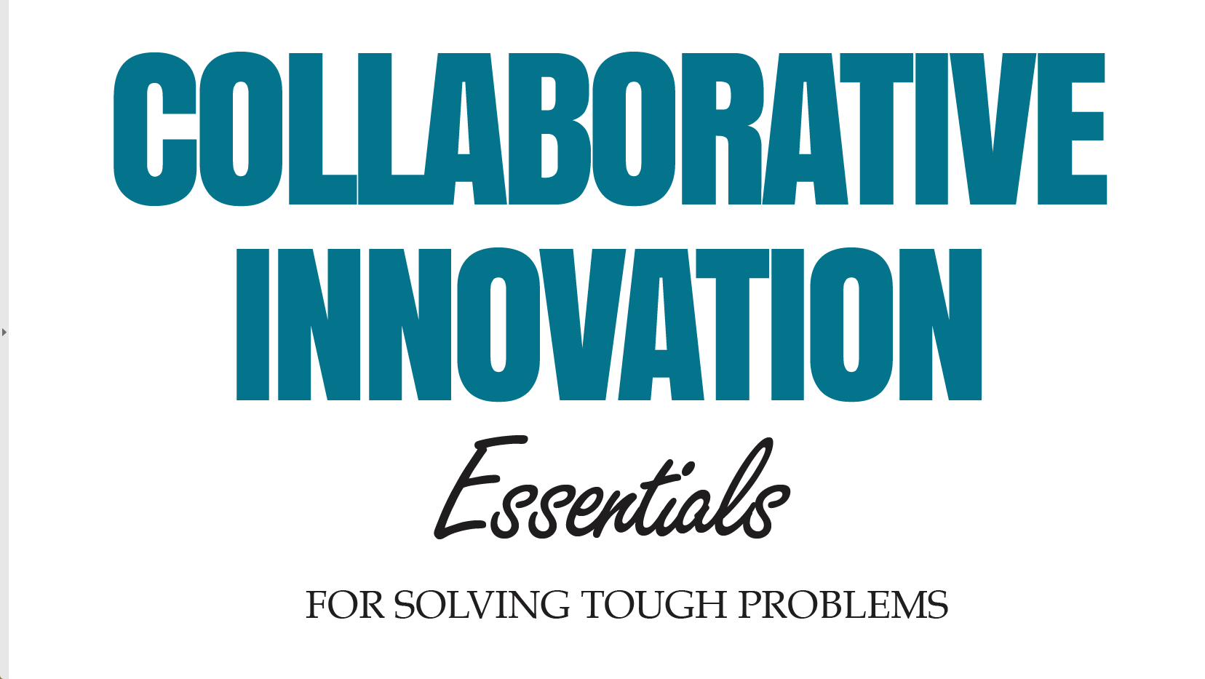

Slide 2
Mapping the System:
Generating a Shared Understanding of What’s Going On

Slide 3
Who we are
CoCreative helps people who don’t know each other (and often don’t even like each other) solve complex problems and create better futures together.
We work across sectors and industries, in public policy, development, energy, food, education, leveraging deep partnerships to create more thriving and resilient social systems.
We do this by designing and supporting collaborative innovation networks and collaborative strategy for high-impact social ventures.

Slide 4
Five Reasons to Map the System Together
It’s a FAST way for everyone involved in your initiative to:
See the whole landscape of actors and forces around the person closest to the pain, including those that aren’t immediately obvious from the user perspective
Identify the forces that are blocking the change we seek
Identify strategic leverage points that can help catalyze the change most powerfully
Learn who else’s experience is important to understand and shift
Have everyone contribute to both analysis and solutions

Slide 5

We Map the System for People
For change to make a real difference, it needs to change the real experiences of real people.

Slide 6






We Map the System for People
To rapidly and sustainably change a real person’s experience, we need to change the system around that person.

Slide 7
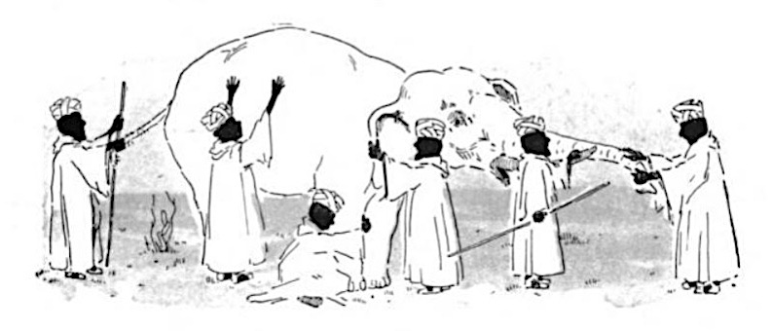
Siloed Perspectives

Slide 8
Seeing the System
Mapping helps us see the parts of the system and the dynamics among those parts, so we can strategically intervene
ACTORS:
Individual
actors
Institutional
actors
FORCES:
Forces for the change
Forces against the change
INTERVENTION POINTS:
Choice points
Leverage points
Pressure points

Slide 9
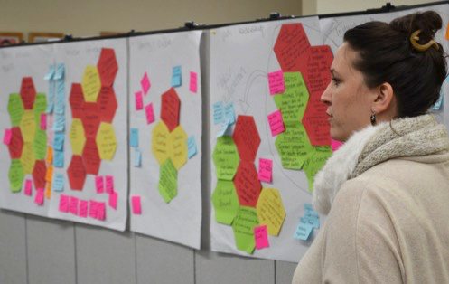
WHEN Especially helpful when you need people to thoroughly understand a complex situation together, identify possible pathways to action, and build genuine commitment to working together.
WHO Works well for groups of up to 30 people working on issues that are complex and not well defined. Participants should represent a diversity of perspectives on the challenges and be able to commit resources to addressing the challenge.
Constellation Mapping

Slide 10
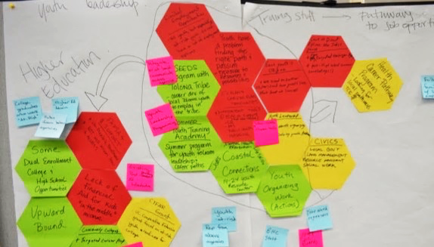
Constellation Mapping

Slide 11
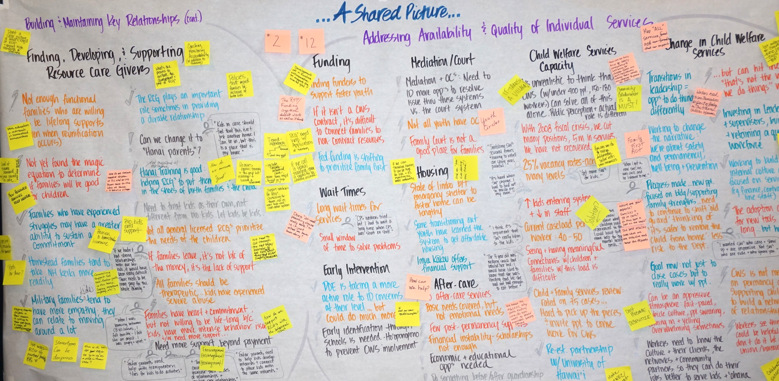
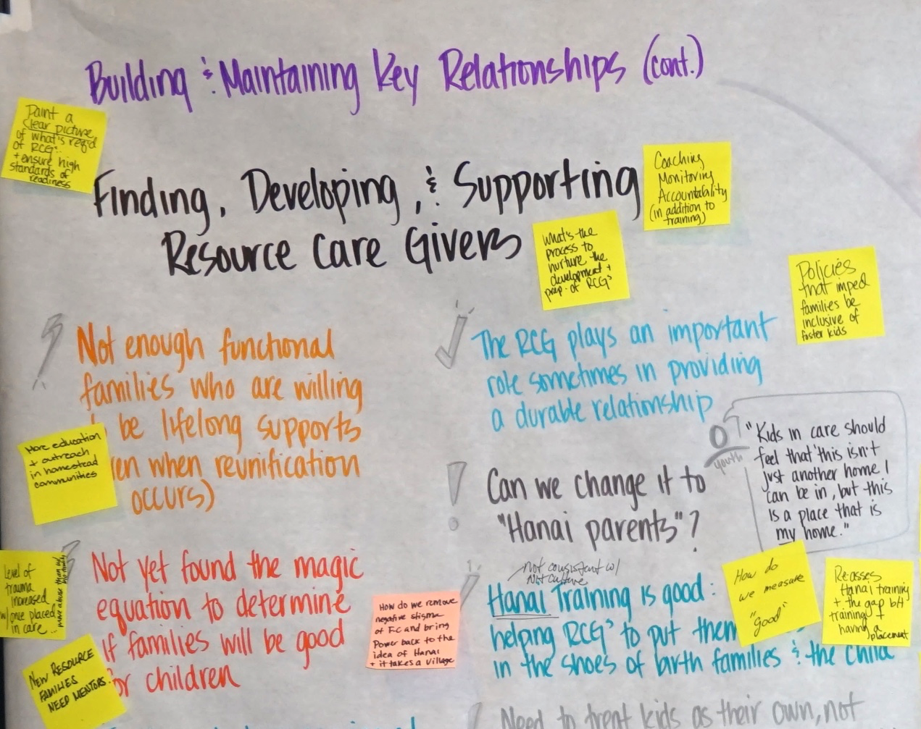
Constellation Mapping

Slide 12
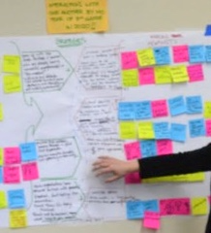
WHEN Especially helpful when the success of your initiative depends on certain people (e.g. doctors or people with diabetes) changing their behaviors. It’s also effective at quickly capturing general forces that need to be addressed.
WHO Participants who are familiar with the interests and concerns of those people who are influencing ultimate success of the work.
Force Field Mapping

Slide 13
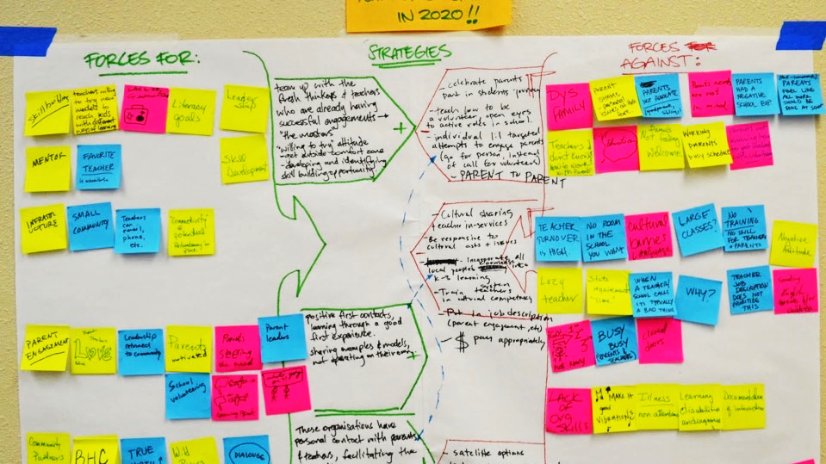
Force Field Mapping

Slide 14
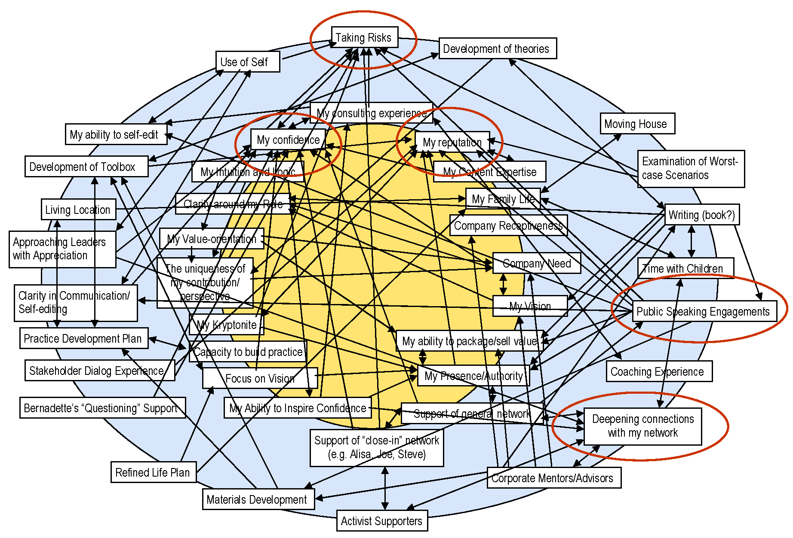
WHEN Especially helpful when things aren’t moving forward and there seem to be underlying issues that hold things back. The process helps push a group to think harder about what’s really holding back progress.
WHO A diverse group of stakeholders who care about solving the challenge but seem to bring diverging perspectives on how to do it.
Key Factors Mapping

Slide 15
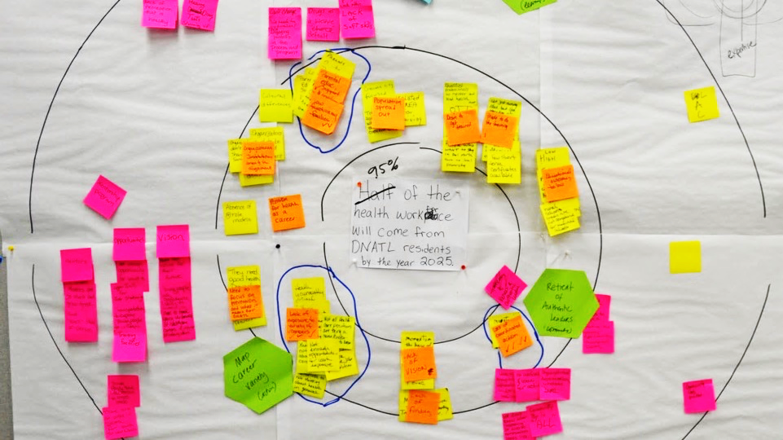
Key factors mapping
Key Factors Mapping

Slide 16
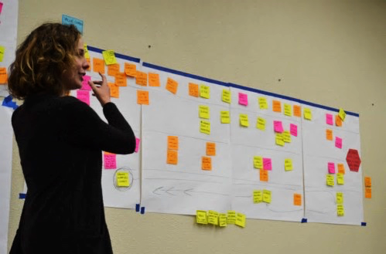
WHEN Especially helpful when a better product or service needs to be delivered to consumers, citizens, or institutions (e.g. healthier school food).
WHO Most effective when the participants represent the various actors along the value chain, because we ultimately need to learn how to design things so that everyone gets a good deal.
Value Chain Mapping

Slide 17
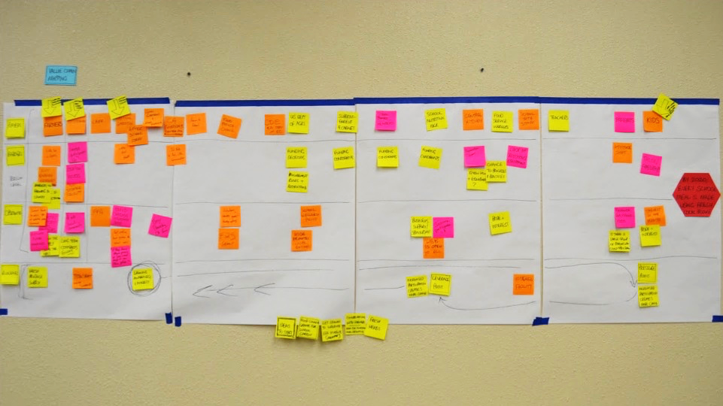
Value Chain Mapping

Slide 18
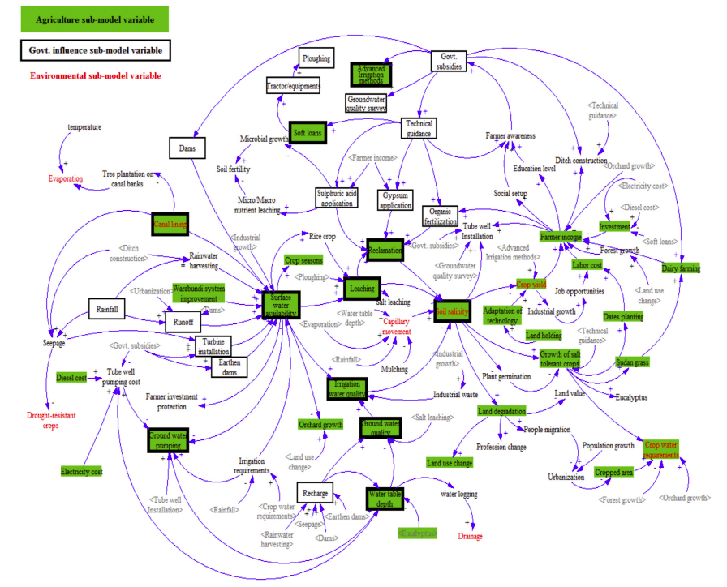
WHEN Especially helpful when the system is highly complex with many factors interacting to influence the outcomes from the overall system.
WHO Most effective when you have a group that represents the whole system being diagrammed and a facilitator who’s experienced with causal loop diagramming.
Causal Loop Diagramming

Slide 19
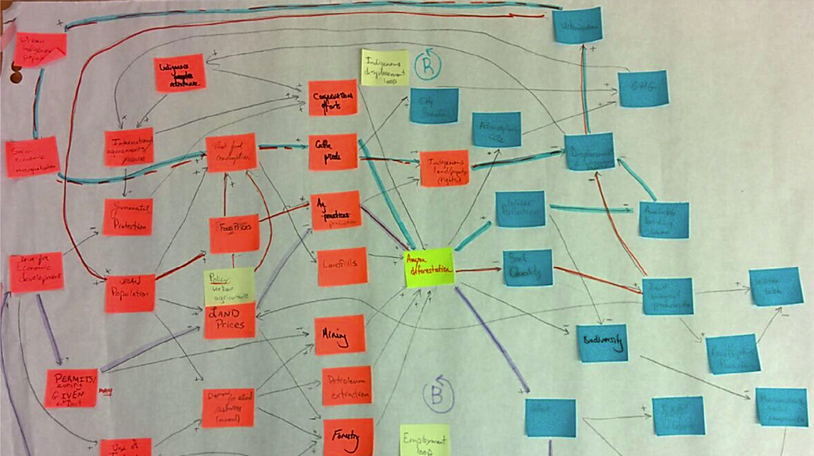
Causal Loop Diagramming

Slide 20
Key Steps for Successful Mapping
Use powerful goals that focus the inquiry
Get the right people in the room—those who represent the diversity of experiences within the system, and can bring resources and/or perspective
Choose the most appropriate method to map the specific type of system
Define the critical shifts that need to happen

Slide 21
More learning, tools, and resources
Free tools and materials on our website:
www.cocreativeconsulting.com/tools
And we’d love to hear from you!
talktous@cocreativeconsulting.com
Don’t forget to send us a tweet!
@WeAreCocreative
Training courses:
Collaborative Innovation Essentials
(DC, Seattle, & Oakland)
Collaborative Leadership Essentials
(DC & Oakland)
Leveraging Conflict for Innovation
Design & Systems Thinking for
Transformational Change
Advanced Collaborative Leadership

