Slide 1
Ideation Essentials: Brainstorming for Transformative Ideas
www.cocreativeconsulting.com

Slide 2
Who we are
CoCreative helps people who don’t know each other (and often don’t even like each other) solve complex problems and create better futures together.
We work across sectors and industries, in public policy, development, energy, food, education, leveraging deep partnerships to create more thriving and resilient social systems.
We do this by designing and supporting collaborative innovation networks and collaborative strategy for high-impact social ventures.

Slide 3
Four Reasons to Brainstorm Well
More Ideas The more good ideas we can draw from, the more likely we’ll move beyond favored solutions.
Better Ideas Effective brainstorming generates ideas that are more specific, impactful, and compelling.
Opens Up Thinking Helps us consider the problem and potential solutions in new ways.
Expands Energy Generates energy from creative engagement and builds energy for the work ahead.

Slide 4
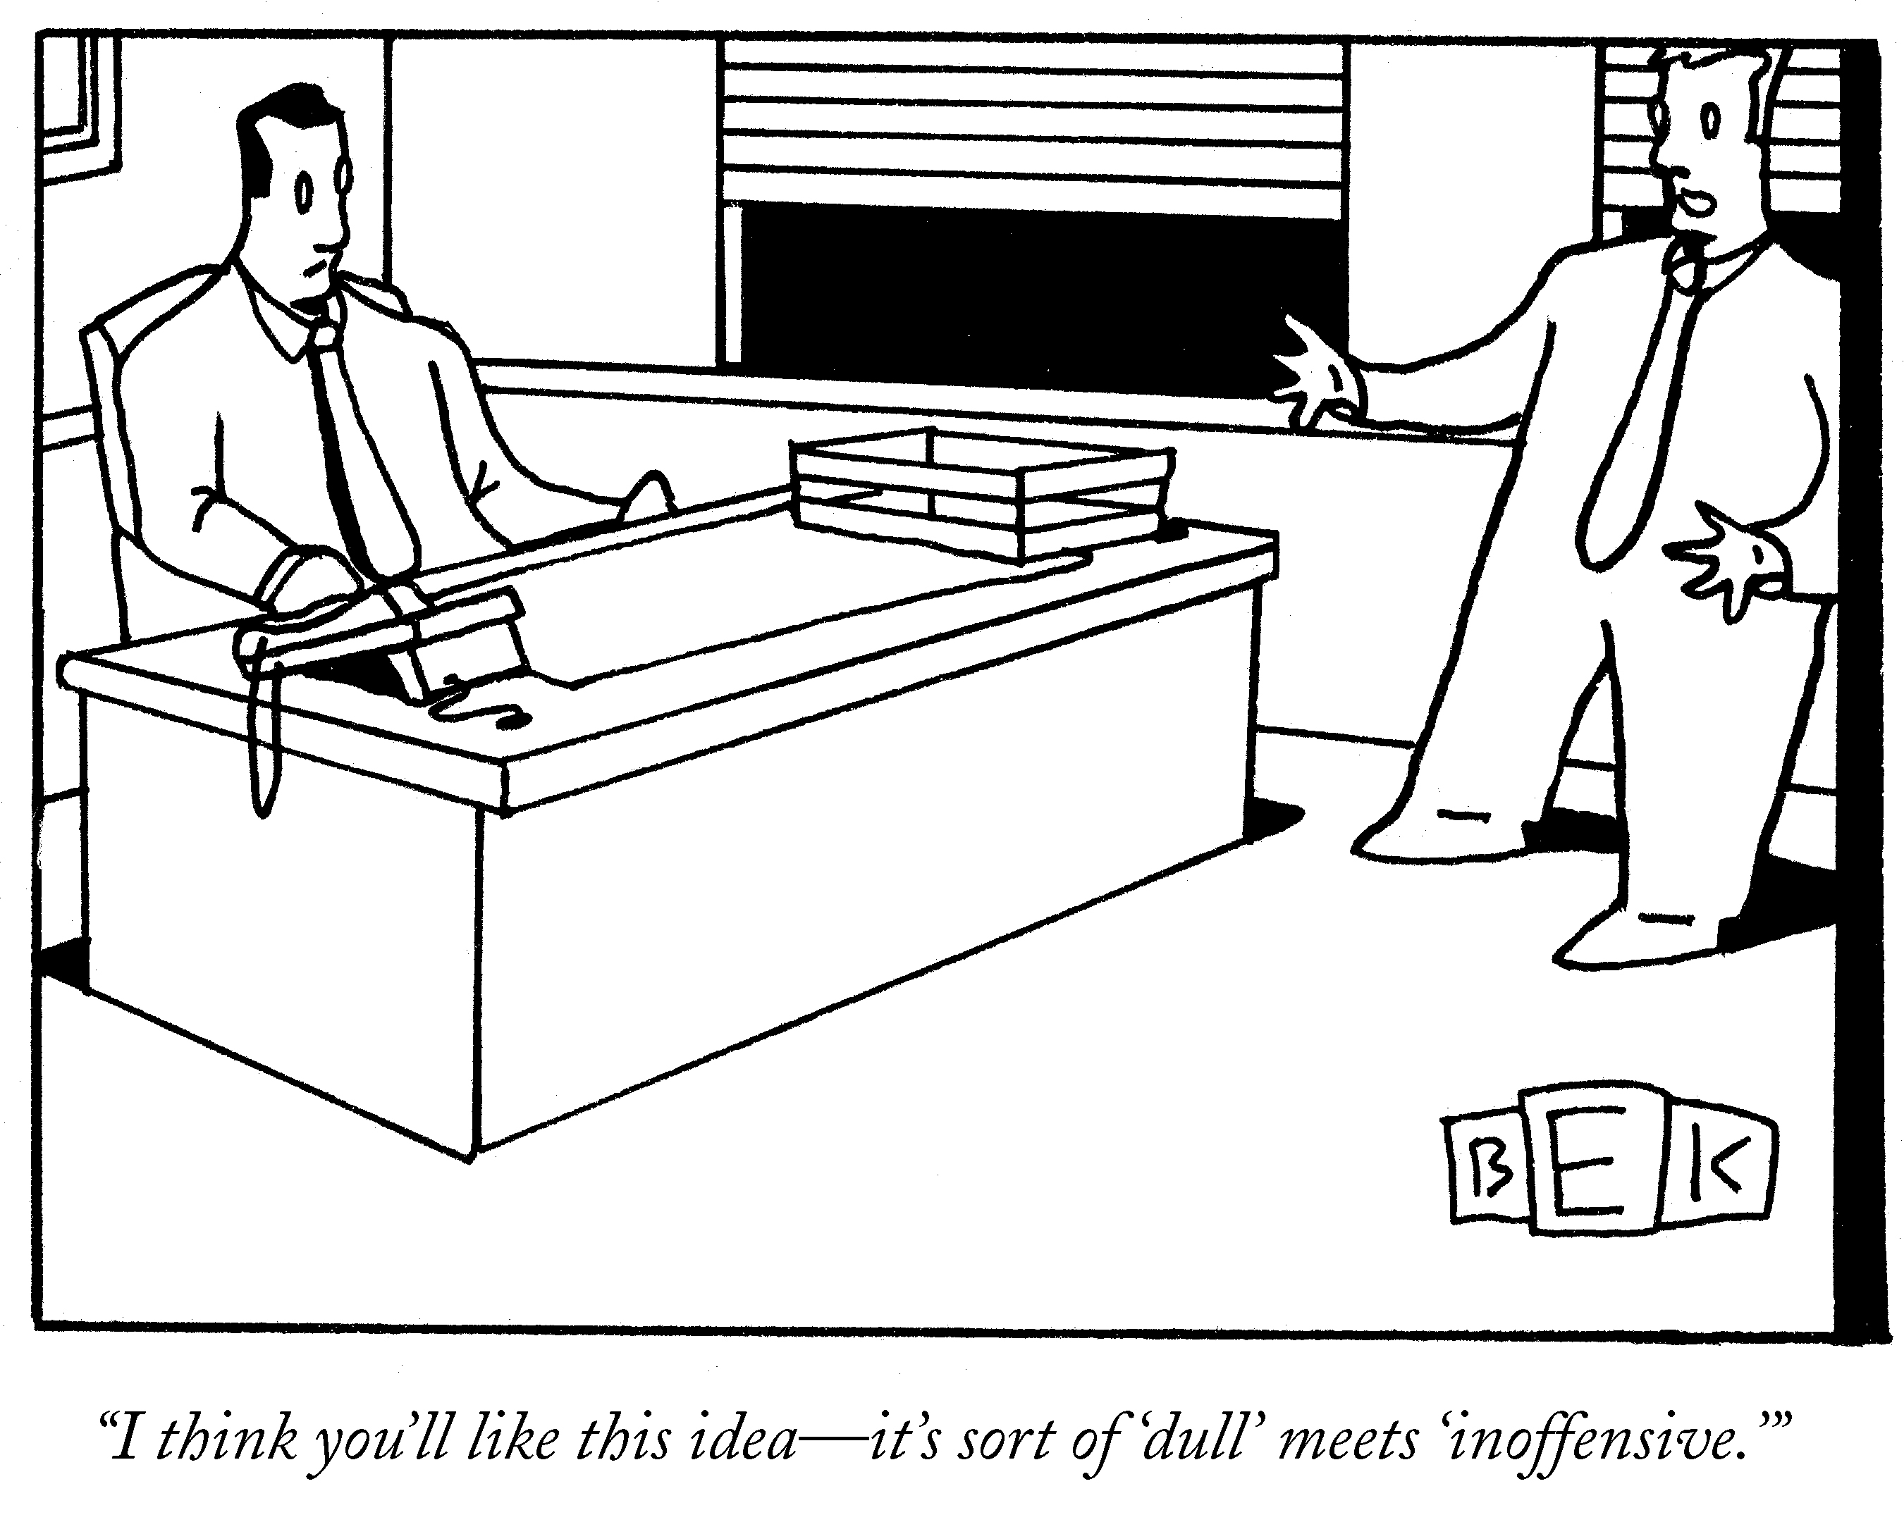
A Bad Idea
Bruce Eric Kaplan The New Yorker Collection The Cartoon Bank

Slide 5
4 Barriers to Good Brainstorming
Rabbit Holes Don’t get bogged down in discussion. Only discuss an idea enough to help clarify it, and no more.
Group Think Break away from the pattern of generating more of the same types of ideas, or just adding variations of a single central idea.
Perfectionism & Critique Ideas are fragile things and they die easily. Adding to an idea produces much better output than tearing it apart.
Being Safe The most compelling ideas are specific and provocative. Avoid trying to make your ideas appealing by keeping them general and unspecific.

Slide 6
What an Idea Is…and Isn’t
An Idea is…
a concrete action (programs, services, initiatives, etc.) that can be take toward a specific outcome.
Example: “Get more architects elected to public office to ensure a ‘seat at the table’ on public design decisions.”
An Idea is not…
A thought or a statement about an issue, or a declaration or assertion about a challenge or opportunity.
Example: “Architects need to have a seat at the table on public design decisions.”

Slide 7
Brainstorming Methods
Brainstorming in a Box (and Design Principles)
Used extensively by CoCreative’s partner firm ThinkPlace, this method is often more productive than convention open-ended brainstorming because it applies more constraints on ideas, not fewer. These constraints are often called Design Principles. When people start listing the reasons an idea won’t work, consider it a gift. We can turn those critiques (and the reason people like the idea) into a working set of design principles that can inform the design of even better solutions.
Working in small groups, take 10 minutes to generate 10 high-quality ideas. Every idea must follow a set of design principles (samples below):
Design Principles
Be “prototype-able” within 6 months
Have a measurable impact
Make a big difference
Require NO resources beyond what we have

Slide 8
Brainstorming Methods
Brainwriting
Developed in the last 1960’s by Bernd Rohrbach, brainwriting is a simple technique to engage all participants more fully in the brainstorming process. Brainwriting has the benefits of quiet reflection while also building on others’ ideas, which can produce better-quality ideas for groups with many introverts or non-professionals.
Here’s our version:
Begin with each participant or small groups of participants in front of flip chart paper on the wall.
Have everyone silently add their ideas to the sheet in front of them.
After a few minutes, have the individual or small groups shift to the next sheet, read the ideas there, and add to these.
After 10 to 15 minutes, walk the whole group around the room, and have the group “harvest” their favorite ideas from the long lists.

Slide 9
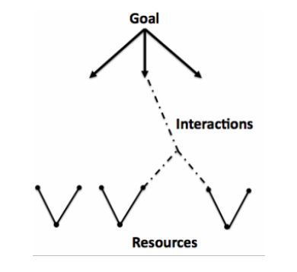
Brainstorming Methods
Brainswarming
Developed by Dr. Tony McCaffrey, this simple technique appeals to different thinking styles and creates very feasible ideas by connecting problems to solutions.
Here’s how it works:
Write a goal or problem at the top of a large sheet
Then write the major resources available to meet these problems at the bottom
Then invite participants to add ideas for tackling the problem from either end, making relevant connections between problems and resources as you go.

Slide 10
4 Tips for Better Brainstorming
Appoint a facilitator/timekeeper
Clearly define roles. Agree on one person in the group to lead the brainstorming, and keep the group on time.
Use Quiet Time
No matter what technique you use, it’s helpful to offer participants 2 minutes of quiet time to generate ideas on their own, and then share them as a group and generate more.
Stand up & move fast
Have the group stand up around a flipchart on an easel or against the wall. Standing up keeps the energy flowing, helps people think on their toes and move fast to yield powerful results in the least amount of time.
Follow the ‘yes, and’ principle
Have groups respond with ‘yes, and’ instead of ‘yes, but’. The surest way to get to better ideas is through improv—by taking a promising concept and building on it.

Slide 11
More learning, tools, and resources
Free tools and materials on our website:
www.cocreativeconsulting.com/tools
And we’d love to hear from you!
talktous@cocreativeconsulting.com
Don’t forget to send us a tweet!
@WeAreCocreative
Training courses:
Collaborative Innovation Essentials (DC, Seattle, & Oakland)
Collaborative Leadership Essentials (DC & Oakland)
Leveraging Conflict for Innovation
Design & Systems Thinking for Transformational Change
Advanced Collaborative Leadership

