Slide 1
Developing Insight: Mining Interview Data for Powerful Insights
www.cocreativeconsulting.com

Slide 2
Who we are
CoCreative helps people who don’t know each other (and often don’t even like each other) solve complex problems and create better futures together.
We work across sectors and industries, in public policy, development, energy, food, education, leveraging deep partnerships to create more thriving and resilient social systems.
We do this by designing and supporting collaborative innovation networks and collaborative strategy for high-impact social ventures.

Slide 3
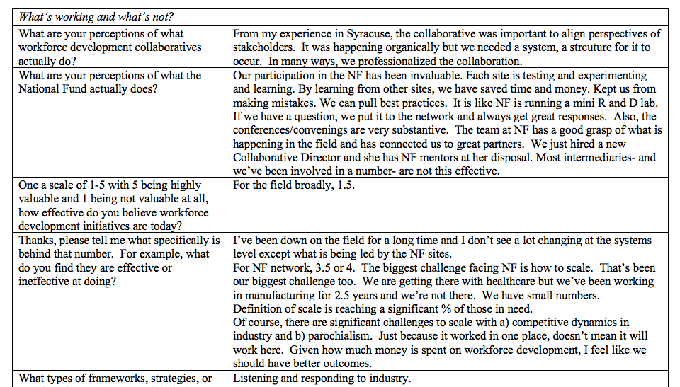
Raw interview notes

Slide 4
Themed insights

Slide 5
Why Develop Insights?
Makes the Data Useful Raw interview data is messy and hard for people to make sense of in real time. Processing the data into thematic areas makes it easy to understand and use.
Provides Focus Deriving key insights from reams of interview data will help people focus on the parts of the system that are most useful and relevant.
Provides Direction Good insights imply some direction for the work. They help people see pathways for moving forward from the current state to a much better future state.

Slide 6
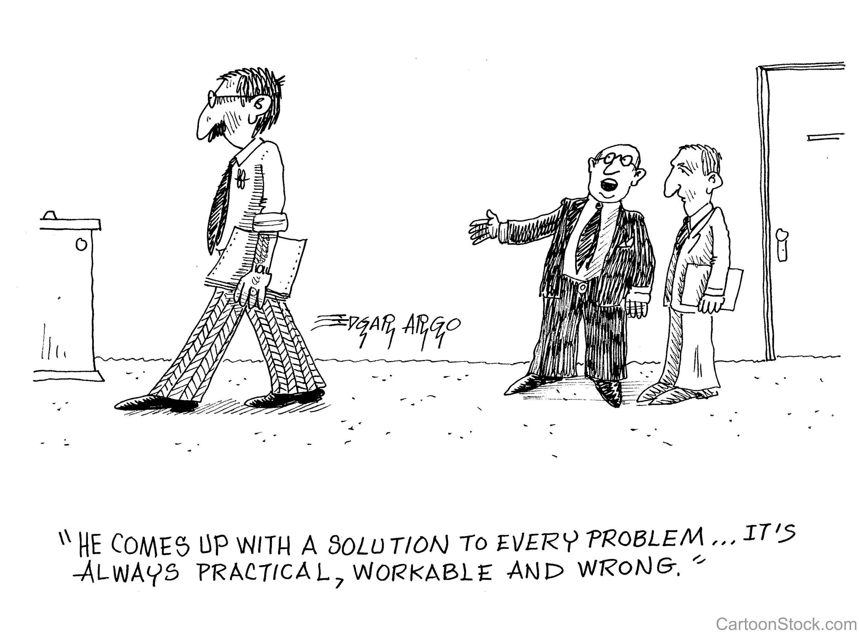
The Problem with Solutions

Slide 7
Four Rules for Developing Powerful Insights
Frame the Problem Clearly state what’s currently going on in the system so people can agree on how parts of the system most need to be addressed BEFORE they start talking about solutions. (POSSIBLE solutions or directions are okay though!)
Clarify the Perspective Distinguish between what leaders and experts are saying about the system and what people are sharing about their experiences within that system.
Be Clear Ensure that each piece of insight is clear, unique, and simple.
Be Objective Turn assertions and opinions into statements about the system. Indicate whether some, most or all stakeholders shared that perspective.

Slide 8
Frame the Problem (Don’t Solve It)
Don’t List Solutions Stakeholders will naturally share their opinions on how to fix a problem. But presenting solutions up front will create an “all-or-nothing” dynamic where everyone will start pushing—and fighting over—their favored solutions.
Helpful
Most farmers are interested in financial benefits, productivity, water, soil quality, and erosion prevention, even if they don't believe in climate change.
Not Helpful
We need John Deere, Monsanto, and the farming community, Aviation (jet fuel from carbon farming), to come together in a coalition to influence Policy makers.

Slide 9
Clarify the Perspective
Capture both the System and Experience views of the system
Change requires understanding both the “whole system” perspective and the ground-level experiences of key stakeholders in the system.
Expert View Example
“Global US-based food companies have a big influence on production by international sources.”
Empathic View Example
Consumer: “I’m confused by all the certifications on food labels. I don’t know which one to trust, and I frankly don’t feel like putting in the effort to sort it all out.”

Slide 10
Be Clear
Ensure each Statement is Distinct
Avoid paragraphs of comments that touch on several points that actually belong in different places. Instead, break up separate points and place them in appropriate clusters.
Edit Statements as Needed
We don't attribute these statements to the stakeholders directly so we can edit for clarity and simplicity.
Don’t overgeneralize
Use "some" or "many" whenever referring to population rather then generalizing. For example, not "Farmers believe X," but "Some farmers believe X."

Slide 11
Be Objective
Avoid opinions and assertions
Turn assertions into possibilities or statements of a potential need. For example, not "We need to" but "Doing X might be effective.”
Objective statements can be neutral, positive or negative
It is important to write statements that clearly indicate whether the insights is an opportunity (+), challenge (-), or a neutral force that might influence the work either way ( ). The best way to do this it to create a column next to the insights and mark each statement whether with a +, -, or blank for neutral.

Slide 12
4 Steps for Developing Effective Insights
Clean up the insights from your interviews Follow the 5 rules for developing powerful insights on the previous two slides.
Group the insights by thematic area. Print out the insights, cut them into separate points, and start to cluster them based on parts of the system, value chain, stakeholder group, or issue areas. Place the statement where its implications lie, not based on who said it.
Make a short narrative in each cluster. In each group, develop a flow of insights that paints a picture about what's happening in that area, almost like the outline of a report. Start with neutral statements, then move to positives, and then negatives (since these prompt thinking about things we can fix).
Use specifics for definition and color, but keep the narrative at the 30,000 foot level.

Slide 13
More learning, tools, and resources
Free tools and materials on our website:
www.cocreativeconsulting.com/tools
And we’d love to hear from you!
talktous@cocreativeconsulting.com
Don’t forget to send us a tweet!
@WeAreCocreative
Training courses:
Collaborative Innovation Essentials (DC, Seattle, & Oakland)
Collaborative Leadership Essentials (DC & Oakland)
Leveraging Conflict for Innovation
Design & Systems Thinking for Transformational Change
Advanced Collaborative Leadership

